Slide 1

INSC Workshop 02-23 Meeting
Latin America Section / American Nuclear Society
27th September 2023
Vienna, IAEA 67th General Condference
Orpet J M Peixoto
orpet@uol.com.br
1st INSC Vice Chair

Slide 2
INSC Workshop 02-23 Meeting
Workshop
(a) Governance of the particular Society presenting
https://las-ans.org.br/
(b) Updates on Nuclear situation in the Society's country and the Region
(c) SMR situation in the Region

Slide 3
Latin America Society OBJECTVES
The Latin American Section of the American Nuclear Society (LAS/ANS) was created on 14th April 1975 with the aim to represent the interests of the nuclear professionals of Latin America;
It gathers the nuclear communities of the Latin American region from Mexico to Argentina, including Central American, South American and Caribbean countries. The Section headquarters is located in Rio de Janeiro (Brazil);
Objectives
The main objective of the Section is to further the development of nuclear science and technology in the fields of industry, agriculture, medicine, energy and related activities, with emphasis in promoting the integration of the different areas of the nuclear activity in the Latin American region.
Other objectives are promoting nuclear research and education; exchange of information; promoting technical meetings in the region to discuss scientific and technical contributions, and cooperation with governmental and international agencies, educational institutions, and other organizations with same objectives, as well as to provide due recognition to individuals and institutions having held an outstanding role in the nuclear development of the region.

Slide 4
Latin America Society Governance
Executive Committee
  4 Officers: Chair, Vice-Chair, Secretary and Treasurer;
  9 Members elected for 3-year terms;
  1 Member inmediate-past Chair.
  Each year, elections are held for Officers to hold office during a one-year mandate and for one-third of the Members reaching the end of their 3-year mandate.
  The Vice-Chair becomes the Chair after ending his one-year term.
  Monthly Meetings (Committees Chairs).

Slide 5
Latin America Society Governance
Committee Chairs - Several Standing and Technical Committees are appointed by the Executive Committee to perform specific functions foreseen in the Bylaws or required by the LAS/ANS annual program.
  AUDITING COMMITTEE
  DEVELOPMENT COMMITTEE
  EDUCATION AND PROGRAMS COMMITTEE
  ELECTION INSPECTION COMMITTEE
  FINANCE COMMITTEE
  HOMEPAGE AND PUBLICATIONS COMMITTEE
  HONORS AND AWARDS COMMITTEE
  MEMBERSHIP COMMITTEE
  NOMINATION COMMITTEE
  IRRADIATION SOURCES APPLICATIONS COMMITTEE
  NUCLEAR ENERGY AND ENVIRONMENT COMMITTEE
  NUCLEAR REGULATION AND LICENSING

Slide 6
Permanent Agenda and International Organizations
Annual Symposium: Annual Meeting, usually in June/July each year, the Section organizes a Symposium on nuclear subjects of relevance for Latin American programs. Meetings on Nuclear Power and the Environment, Operation of Nuclear Power Plants, Nuclear Energy Applications, Strategies for Nuclear Energy Development. The LAS/ANS Symposia is held in different countries (rotation).
Nuclear Week and other special meetings
International Organizations:
International Nuclear Societies Council (INSC) - LAS/ANS is a founder member of INSC. The Section represents the interests of Latin American nuclear professionals, particularly those who have no national Society.
Pacific Nuclear Council (PNC) – Since 1995.
World Council on Isotopes (WCI) - LAS/ANS is a founder member of WCI..
American Nuclear Society (ANS) - ANS is the parent organization of LAS. LAS members have been elected to become ANS Fellows. LAS members have also held governance posts at ANS (Board of Directors, Executive Committee, Finance Committee, Nominating Committee, International Committee, Membership Committee, Special Committee for Nuclear Societies Cooperation, etc.).
United Nations Framework Convention on Climate Change (UNFCCC) - In 2004, LAS/ANS was admitted with Observer Status at this U.N. agency and its representatives attended several United Nations Climate Change Conference of Parties - COP meetings.
Member of the Steering Committee of the N4C Group.

Slide 8
INSC Workshop 02-23 Meeting
Updates on Nuclear situation in the Society's country and the Region

Slide 9

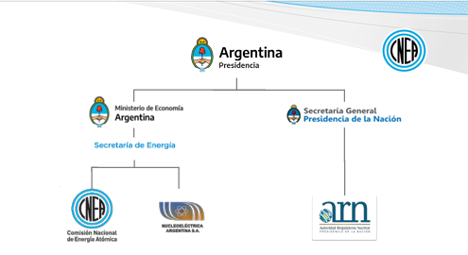
Argentina Nuclear Energy Program
Development of nuclear technology and its fuel cycle;
Basic and applied research;
Nuclear technology in medical applications, food irradiation and environmental protection;
Human resources training.

Slide 10
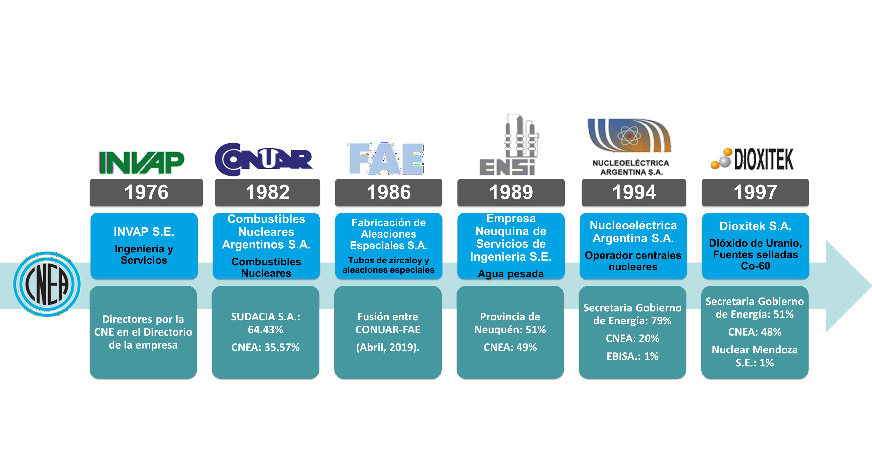
Associated Industries and Institutions
1950

Slide 12

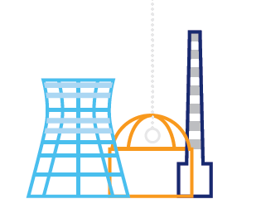
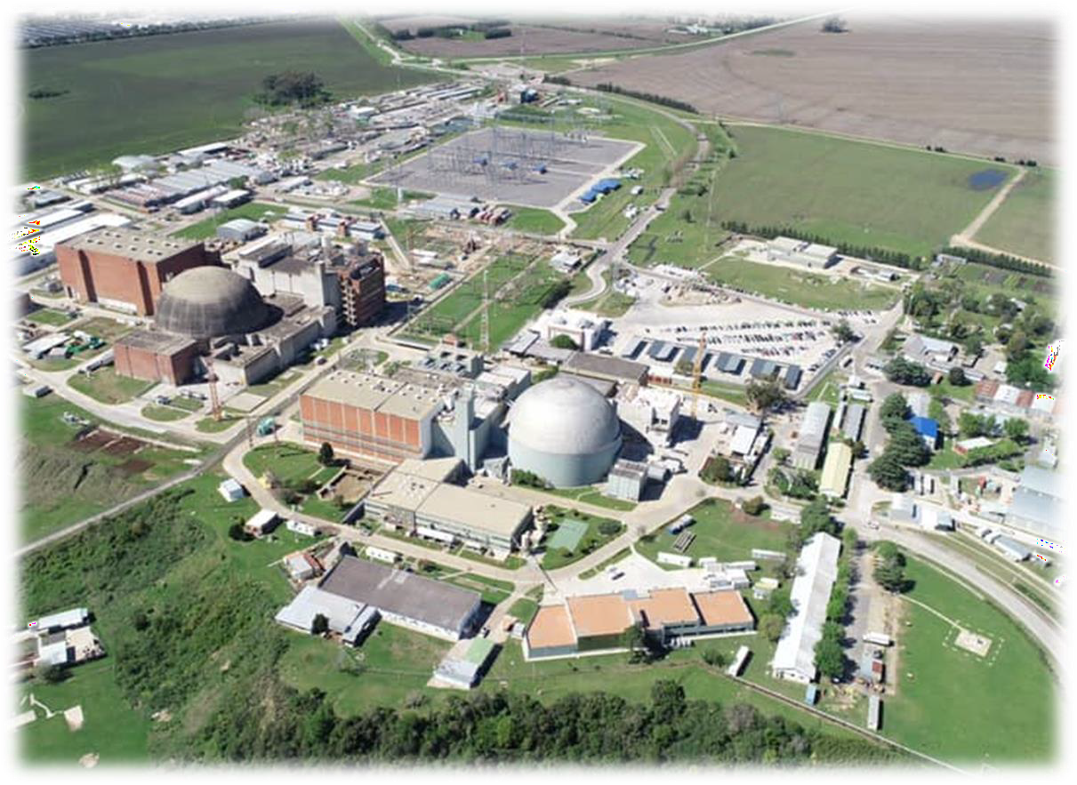
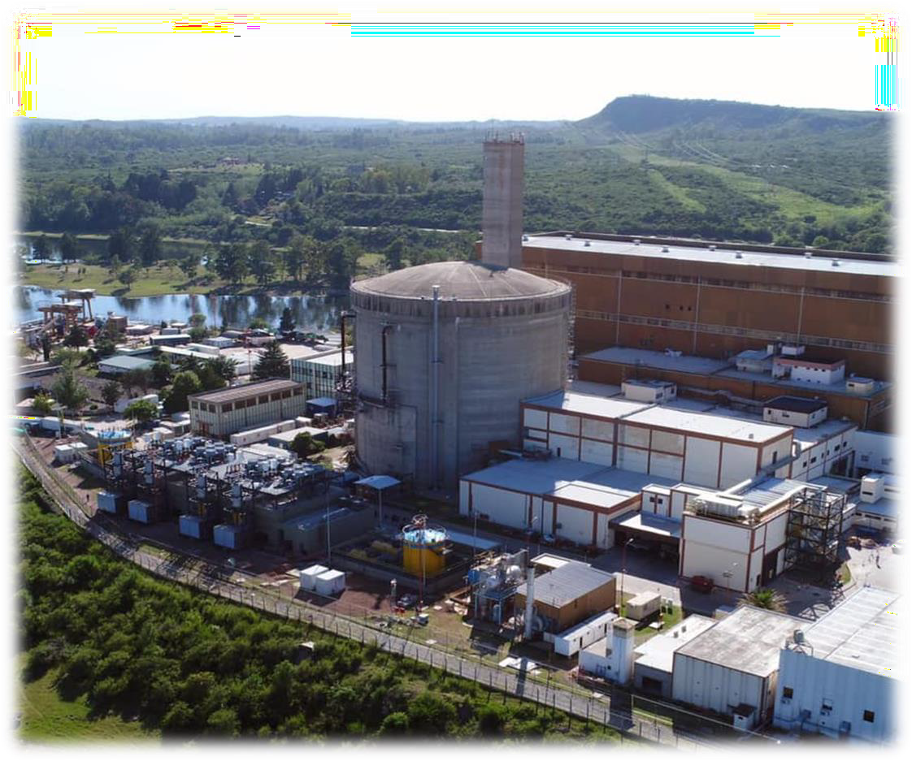
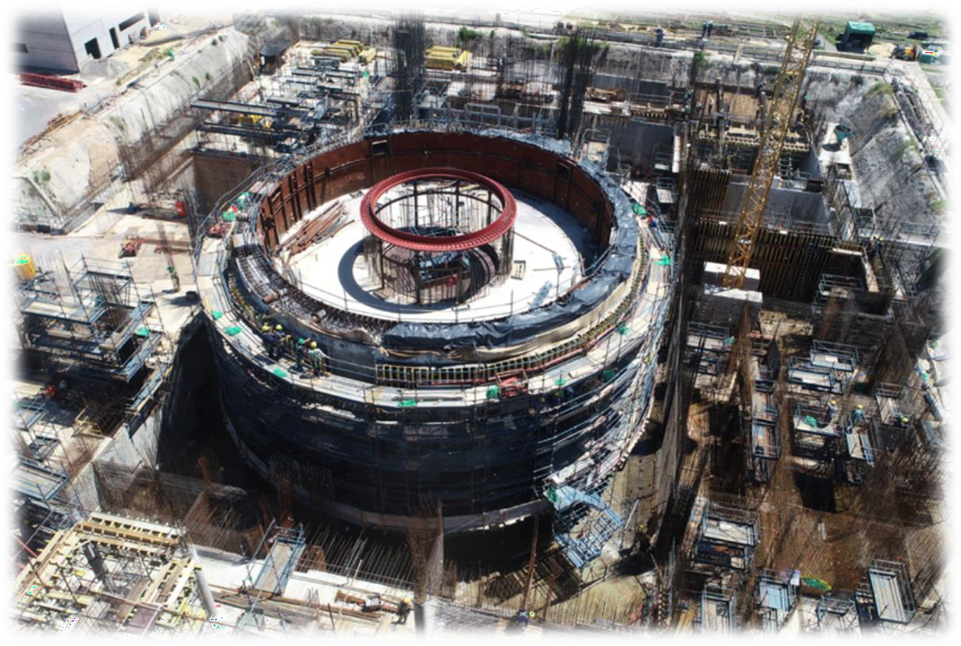

The ARGENTINE REPUBLIC designs, builds and operates nuclear power plants, while facing a process of construction of a Small Modular Reactor (SMR) of entirely national design and develops negotiations with the People's Republic of China for the construction of a Nuclear Power Plant of HPR-1000 technology.
3 NUCLEAR POWER PLANTS IN OPERATION
TOTAL INSTALLED CAPACITY 1763 MWe
1 CAREM NUCLEAR POWER PLANT UNDER CONSTRUCTION (SMR)
1 NUCLEAR POWER PLANT UNDER NEGOTIATION
ATUCHA 1
First nuclear power plant in Latin America (362 Mwe)
ATUCHA 2
Commissioning in 2014 (745 Mwe)
EMBALSE
En 2019 culmiRESERVOIR
In 2019, the life extension tasks were completed, allowing it to operate for 30 more years (656 Mwe)..

Slide 13
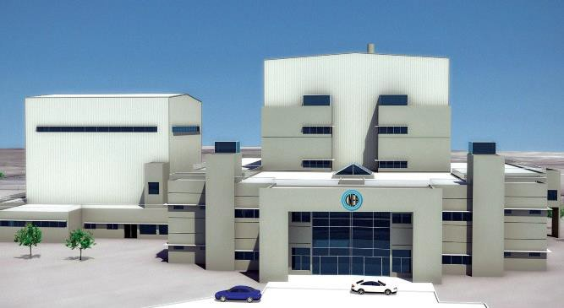
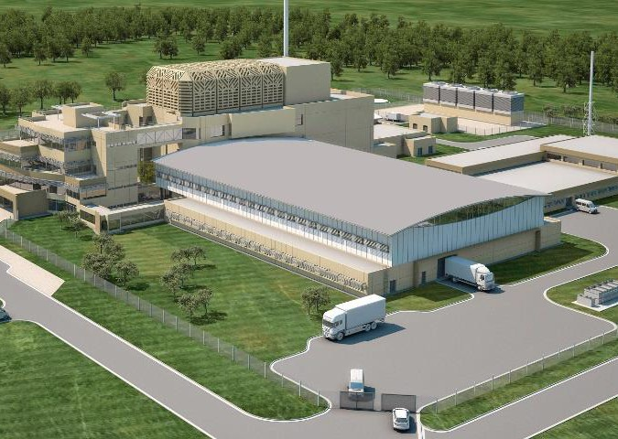
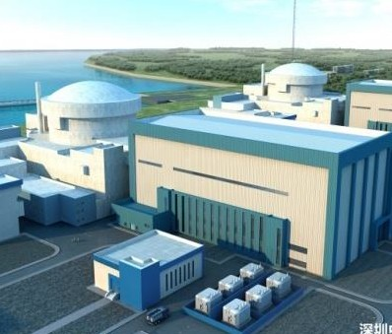
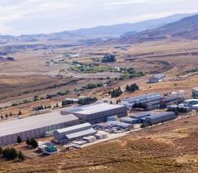
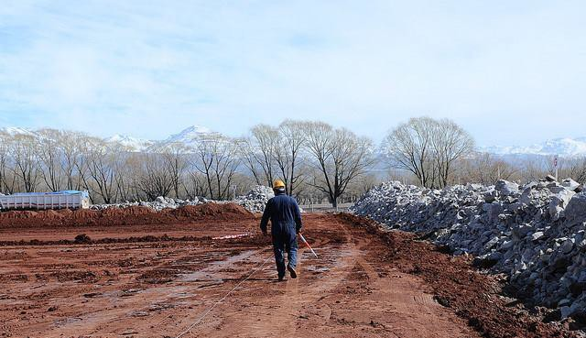
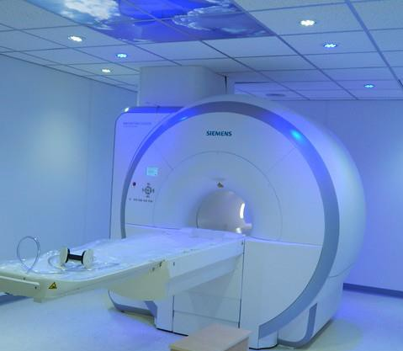
ARGENTINA MAIN ON GOING PROJECTS
CAREM 25
RA-10
Futura Central Nuclear
Uranium enrichment
Environmental restitution
Nuclear medicine

Slide 14
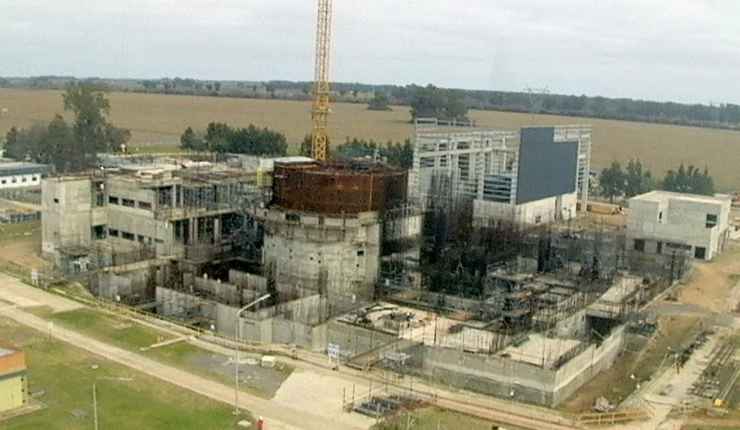
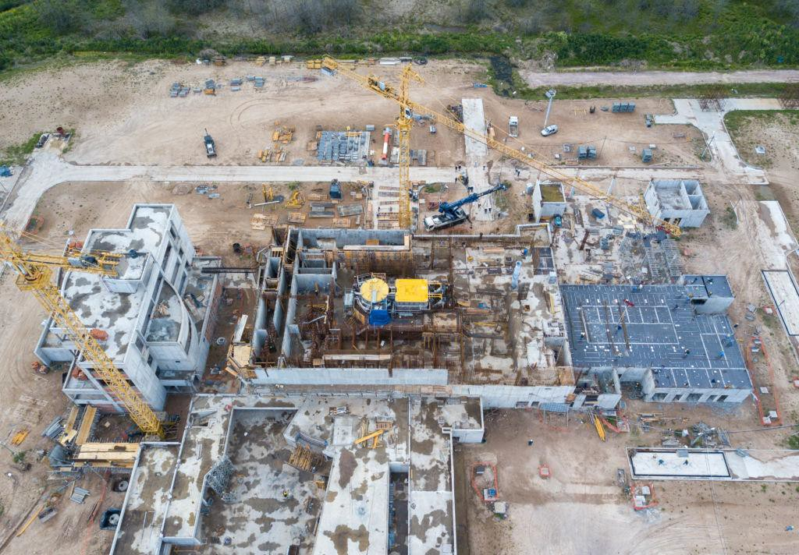
CAREN 25 and Multipurpouse RA 10
Main features
Tipo PWR
Electrical power : 32 MW
Heating capacity : 100 MW
Integrated Primary System
Natural circulation
Autopresurizado
Fuel: Enriched UO2 (3.1 and 1.8%)
Passive safety systems
18-month operating cycle

Slide 15
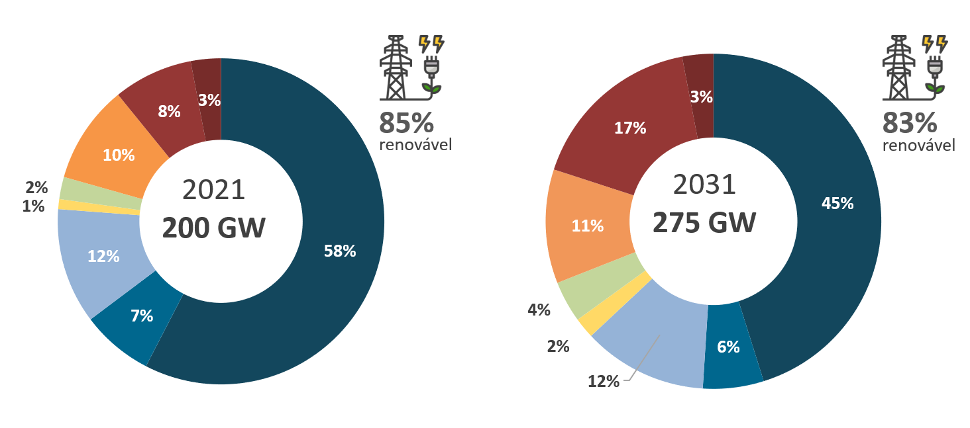
Energy in Brazil
PDE 2031 – Ten Years Energy Planning: installed capacity
Renewable
Renewable
Hydraulic
Renewable thermoelectric
Non-renewable thermoelectric
Nuclear
Solar
Wind
SP + DG Renewable
SP + DG Non-renewable
(EPE, 2023)

Slide 16
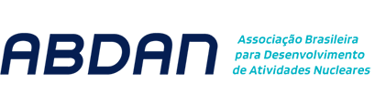
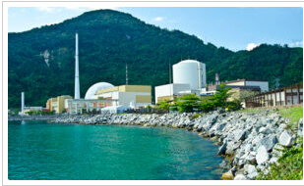
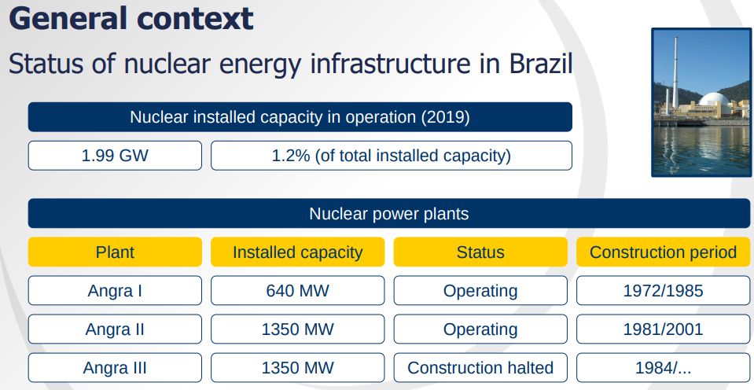
Nuclear energy in Brazil
Nuclear installed capacity in operation (2021)
1.99 GW
1.1% of total installed capacity
Nuclear Power Plants
…2027 (expected)
Uranium Production
Mine
Resources
Status
Production Capacity
Potential Capacity (2027)
Caetité – BA
99 k ton uranium
Operation
400 ton/year
800 ton/year
Santa Quitéria – CE
80 k ton uranium
Project
1,600 ton/year
2,300 ton/year
(EPE, 2023)

Slide 17
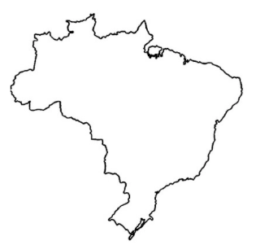
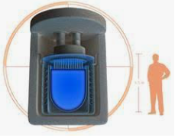
Government Actions on Nuclear Power Generation
Government’s Initiatives in Nuclear area:
  Finalize Angra 3;
  Review the planning for 9 GW in the next 30 years; PNE 2050 – Program for 30 years.
  Option for implementing a SMR on the next 10 years; PDE 2031 – Program for 10 years.
  Changes in the Future - Constitutional Amendment
  Promote Nuclear Technology in all applications. Special effort for Power generation;
  Important growing of Solar and Wind;
  Research and development of a Brazilian SMR and technology application it is relevant on the planning;
  Other applications as medicine, health and food.

Slide 18
Brazil´s Short term PROJECTS
Construction of Angra III
  Acceleration of the critical path for the construction of Angra III
  EPC Contract
EPC Contract
Angra III commercial operation - 2028
Life span of Angra I - 2024 (20 years)- 2045
Life span of Angra iI - 2040 (20 years) - 2060

Slide 19
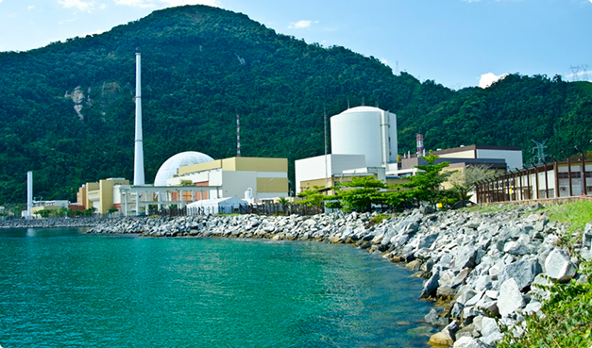
Finishing Angra 3
Eletronuclear and its parent company ENBPar will comply with the Critical Line Acceleration Program
Part of Finalizing with EPC and Final Equipment and System Aquisition
investment plan for the period 2022-2028 – US$ 3 billions
designed to preserve the schedule of works.
The goal is:
  Start EPC - September 2024
  COD - June 2028
2022 2028

Slide 20
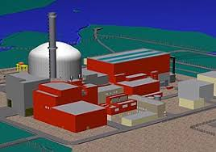
Status of Angra 3 Construction
67.26% of civil works have already been carried out
The overall physical progress of the enterprise, considering all other disciplines involved, is 65.29%
The investment already made is around US$ 1.6 billion
Estimated resources for completion are approximately US$ 3.013 billion - funding by ENBPar

Slide 21
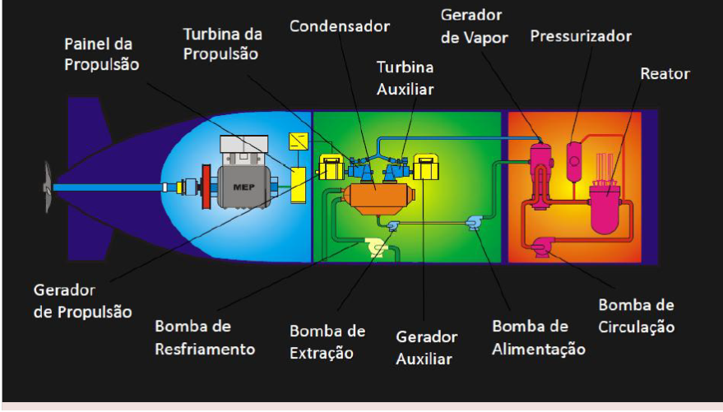
Navy Program – Nuclear Defense Submarine
Schematic Plant
Main Topics
Huge human resource formation
Spin off of Technology
Depend on the government funds
Planning for 2032
More than 2000 staff

Slide 22
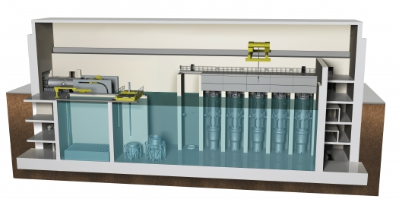
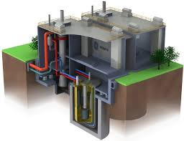
[installed nuclear power capacity between 8 and 10 Gigawatts over the next 30 years]
implementation of Small Modular Reactors - SMR
Localization Study of New Nuclear Sites
AP1000 Project
(Source: Westinghouse)
A Cutaway of the Reactor Building SMR design
(Source: NuScale)
Location of New Sites - Candidate Areas
(Source: Eletronuclear)
EPR Project
(Source: Framatom)
A cutaway of the PRISM design
(Source: GE Hitachi)

Slide 23
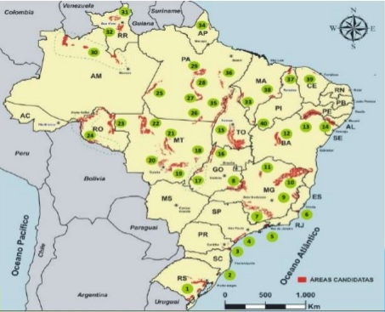
Angra I and II NPP

Slide 24
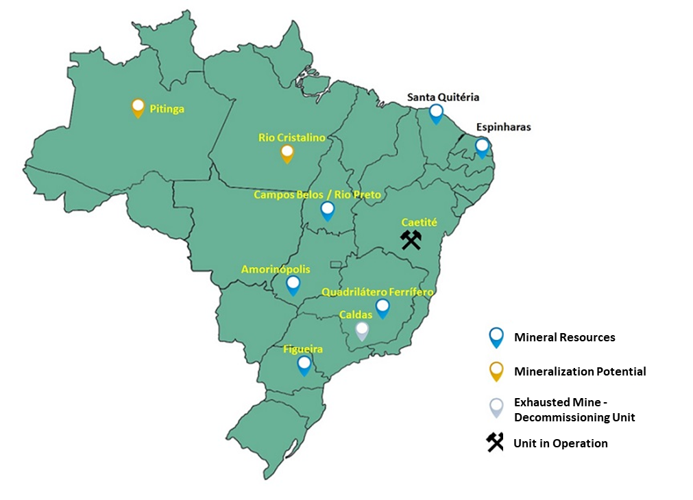
Projects for Uranium Production
Brazilian mineral resources evolved from 9,400 ton (1975) to the current amount of 244,788 ton of U3O8
can be expanded with new research and mineral research since only 33% of the national territory was researched
The northern region of the country has the potential to house more than 300,000 tons of Uranium

Slide 25
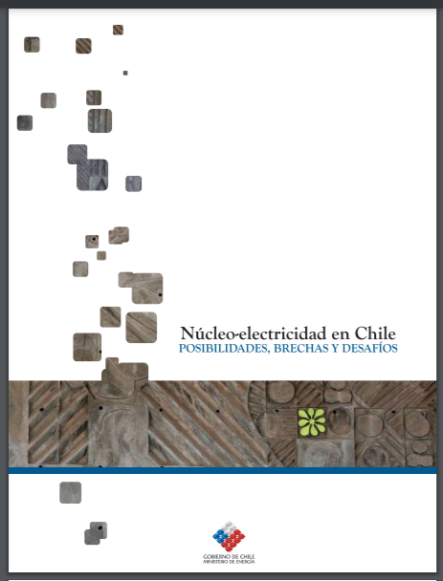
Mexico Nuclear Energy Program
In Mexico, the Laguna Verde Nuclear Power Plant (CNLV) has been operating since 1990 (Unit 1) and since 1995 (Unit 2). These reactors are boiling water type (BWR) manufactured by General Electric.
Both Units have gone through two processes of increasing power, in June 2018, narrow (5%) and extended (120%), in June 2018, the National Commission for Nuclear Safety and Safeguards (CNSNS) granted the license to operate up to 120% of the originally licensed power (1931Mwt).
In June 2020, Unit 1 was granted the renewal of its license to operate for 30 more years. The license renewal of Unit 2 is in process.
increase the percentage of non-fossil energies in the portfolio of primary energy sources for electricity generation by at least 35% by 2024, 40% by 2035 and 50% by 2050.

Slide 26
System (PRODESEN) 2022-2036
Program for the Development of the National Electric
It is the instrument that details the annual planning of the National Electric System with a fifteen-year horizon and that specifies the national energy policy on electricity.
In light of this document, two projects have been contemplated that would expand the installed nuclear capacity in the country:
Consider incorporating into the national electricity system an SMR with the ability to desalinate seawater
Add two more units in Laguna Verde (Unit 3 and Unit 4)

Slide 27
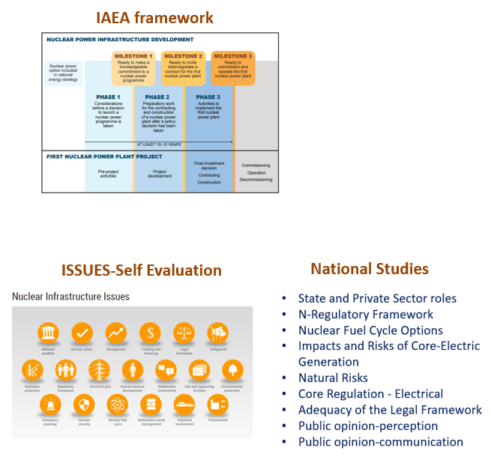
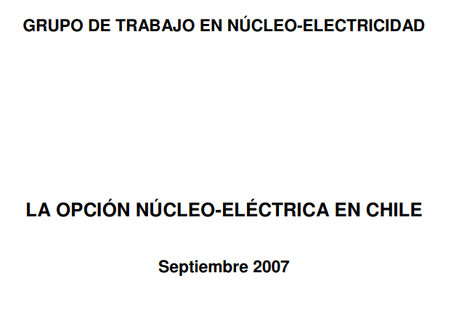
Considering Nuclear Power……
Final Report-2010
First Report-2008
The nuclear option for electricity generation is experiencing a renaissance in the world. The projected evolution of the national energy sector indicates that Chile -in the most probable scenarios- will require nuclear energy at mid-2020s, to support meeting its economic efficiency targets, security of supply and prices, as well as environmental sustainability.
Nuclear energy is not a disposable option and could contribute to the security of electricity supply

Slide 28
INSC Workshop 02-23 Meeting
SMR situation in the Region

Slide 34
SMRs in Brazil – Factors to be considered
Performance and capacity factor;
Licensing and Security:
  Simplicity, speed and experience in licensing;
  Security;
Installation Flexibility:
  Location: SMRs can be installed in hard-to-reach locations and smaller-structure electrical networks;
  Required surface;
  Compact and modular;
  Grid complement;
Costs:
  Construction time: construction and several cases of delays;
  Specific costs;
Supply chain:
  SMRs benefit development and strengthening of component supply markets.

Slide 35
SMRs in Brazil – Capacity and Applications
Brazil has an advanced nuclear technological development;
Help to mastery of the nuclear fuel cycle;
Possibility to leverage the nuclear production chain;
Leveraging the technological development of other Programs(Medicine, Navy, etc.);
Multiple application potential:
  Remote and off-grid region;
  Application in National Integrated System;
  Desalination;
  Hydrogen Production;
  Industrial Purposes;
  Green hydrogen production & synthetic fuel;
Other applications.

Slide 36
Initiatives for SMR in Brazil
Initiatives Supported by Brazilian Nuclear Industry:
  Actions to Support Implementation of SMRs in Brazil - Strategic Plan;
  Permanent Forum on Small Modular Reactors (F-SMR);
  SMR – Action Plan:
    Public policy;
    Regulation, licensing and standardization;
    Industrial policy;
    Development phase – financing support;
    Including SMR in the Electrical Planning;
    Communication plan;
  IAEA Collaboration;
  Events and Seminars.

Slide 37
Initiatives for SMR in Brazil
Define the application of the SMR in Brazil so that it can be placed in the PNE and PDE:
  Promote a discussion forum on the best initial applications of SMR for Brazil - definition of initial applications;
Study Proposal to Identify Licensing Challenges and Solutions (Environmental and Nuclear) for SMRs:
  Encourage technical studies at regulators and academia (conduct studies in the choice defined in (1).
Proposed Study and mapping of SMR sites in Brazil:
  Take action to conduct studies to map the ideal sites for using the SMRs;
Techno-economic study proposal for the implementation of SMRs in Brazil;
  Promote the acquisition of knowledge of technical-economic projects in SMRs in academic and research institutions ;
Proposal for the Development of a Roadmap for the Implementation of SMRs for Brazil:
  Identify and prioritize actions necessary for the development and implementation of the SMR project in Brazil;
  Identify stakeholders necessary to carry out the actions related to that Roadmap.
Actions to Support Implementation of SMRs in Brazil
Strategic Plan

Slide 38
Initiatives for SMR in Brazil
  3 years Forum to create knowledge for SMR application
  TOPIC I: Construction approaches for SMR-based power plants ;
  TOPIC II: Distinctive design and operational characteristics of SMR
  TOPIC III: Critical siting aspects for SMR-based power plants
  TOPIC IV: Specificities of heat applications for industrial processes and hydrogen production
  TOPIC V: Specificities of remote and off-grid applications
  Agreement EPRI and EPE for studying the Brazilian roadmap for SMR
EPE (Energy Research Company)
MME (Ministry of Mines and Energy)
ABDAN
Industry and State Organizations
What technology will be used?
At what cost? Where will they be installed?
What is the technological drag that the production chain in the nuclear sector brings?
How to have a Regulation and Inspection that creates an environment for the implementation of SMR's in Brazil?
Participation in the IAEA CRP - Coordinated Research Project focus in the Economical Aspects of SMRs
Permanent Forum on Small Modular Reactors
(F-SMR)

Slide 39
Initiatives for SMR in Brazil
Need of increasing the awareness and engagement of the society;
Initiatives to demystifying Nuclear and SMR technology – technology, costs, delivery time, security, licensing, etc.;
Highlighting the importance of nuclear source in the energy transition;
Construction of a sustainable demand as a key element for nuclear sector development;
Emphasis on the HR training at all levels (technical, operational, regulatory, research & development, etc.);
Need of State sustainable commitment and support (political and financial) for the nuclear sector;
The inclusion of nuclear investment forecast in the planning documents (PDE and PNE) creates an investment-friendly environment for the nuclear sector chain, including SMRs technology;
The Brazilian engagement and international cooperation (IAEA, IEA, CNSC, NNL, NEA-OECD, SMR Regulator’s Forum) is a key element for SMR success;
Presently is an opportunity for discussing, reviewing and consolidating the the Brazilian regulatory framework.
Economic and Financial Model for SMR application in Brazil
GESEL’s project
(*)

Slide 40
Conclusions for Nuclear in LATAM
Argentina, Brazil and Mexico will continue to increase the Nuclear Energy option;
Goals to increase the Clean Energy will help;
The renewables, Solar and Wind, are Strong Competitors;
The Matrix Mix needs balance with intermitent and base load energy;
SMR can play a important role and change for some countries;
  Create Nuclear Knowledge
Nuclear Medicine and Applications are expected to have a Strong increase;
Nuclear Culture and Human Resources should be looked thru different approaches.

Slide 41
Nuclear Societies in Latin America
  Brazil – ABEN / ABDAN
  Argentina - AATN
  Mexico - SNM
  Chile - CHNS
  Other Countries – Peru, Cuba, Colombia
  Latin America – LAS/ANS – WIN - IYNC

Slide 42
Thank you
Orpet Peixoto
Vice-Chair INSC
orpet@uol.com.br

Slide 43
Acknowledgements
To Brazil ENBPar for the slides and pictures from Brazil
To Argentina CNEA for the slides and pictures from Argentina
To Mexico CNSNS for the slides and pictures from Argentina
To Chile CCHEN for the slides and pictures from Chile

