Slide 1
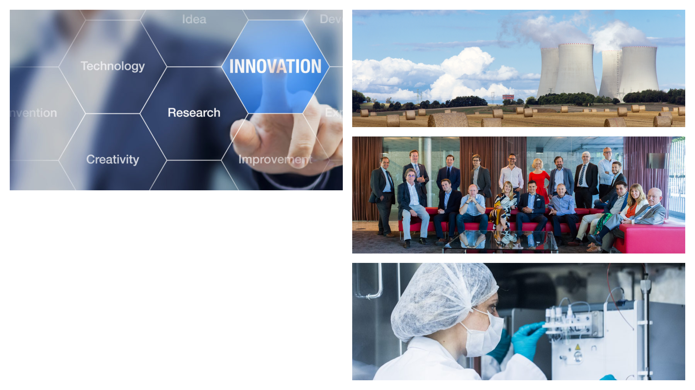


THE LARGEST NUCLEAR COMMUNITY IN EUROPE
  Christian Legrain, Vice-President
  Jadwiga Najder, Science and Outreach Manager

Slide 2


European Nuclear Society
  A Learned Society
  A trustworthy point of reference
  An engaging, international community
Notes:
Many common points in activity of national nuclear society and European – we exist to support you and represent nuclear community on European level
Learned society: organisation that exists to promote an academic discipline, profession or a group of related disciplines.

Slide 3

Who we are
A Learned Society that promotes the development and understanding of peaceful nuclear applications in every field:
  Energy
  Medicine
  Space exploration
  Safety
  ...

Slide 4
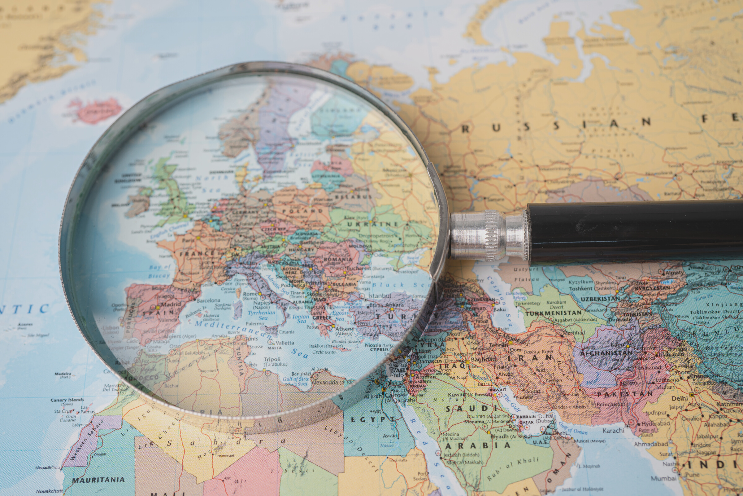
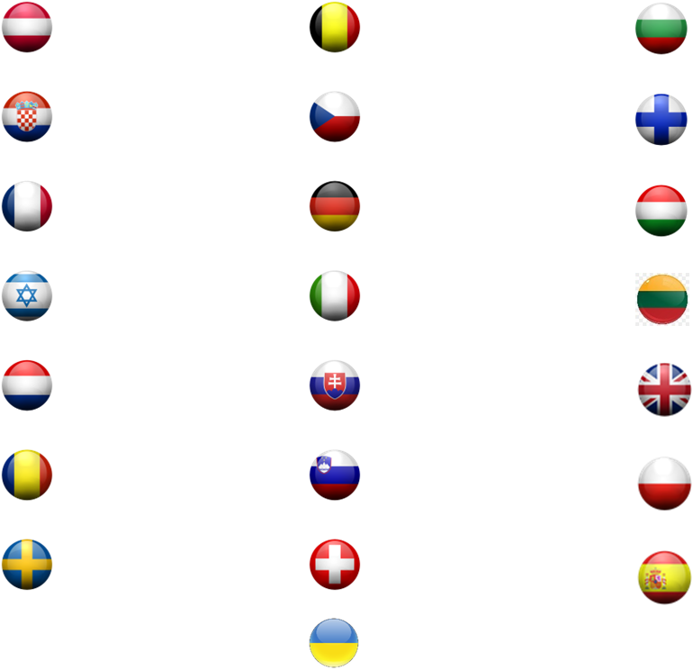
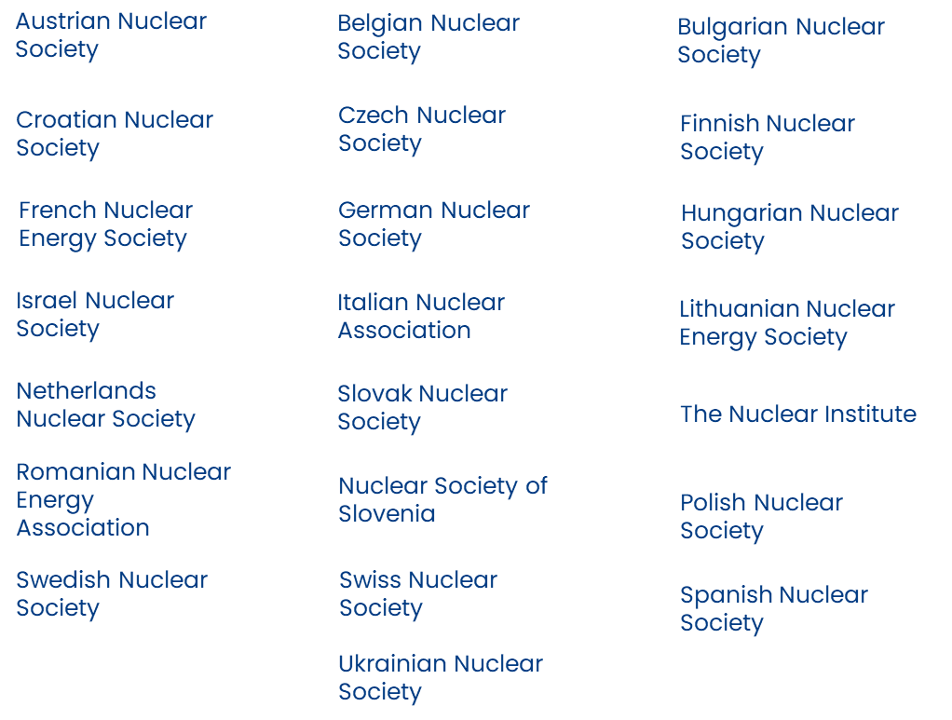
Supporting Scientific Excellence
  22 Member Societies
  +12.000 Members

Slide 5






















Supporting Scientific Excellence
  29 Corporate Members supporting the organisation
Notes:
EIMV – Elektroinstitut Milan Vidmar Slovenia

Slide 6










ENS has strong partnerships with many international nuclear agencies and NGOs
ENS Global Network

Slide 7
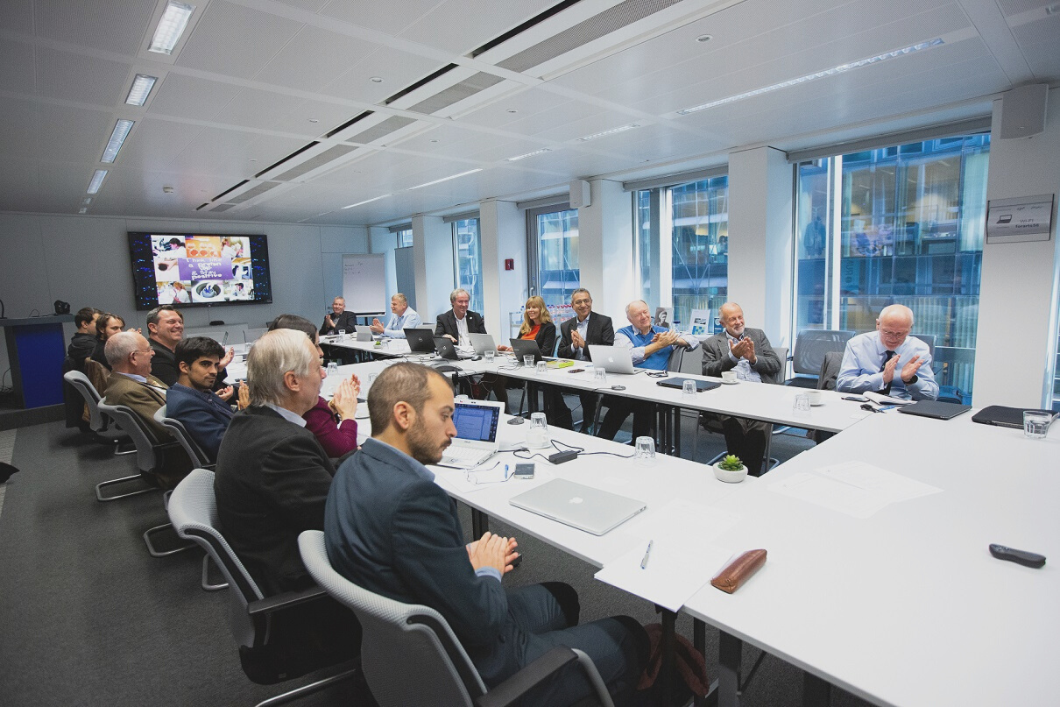
ENS High Scientific Council
  21 scientists of high repute from 16 European Countries
  Position Papers on key topics of interest to the society (climate change, hydrogen production, safety ...)
  ENS PhD Award

Slide 8
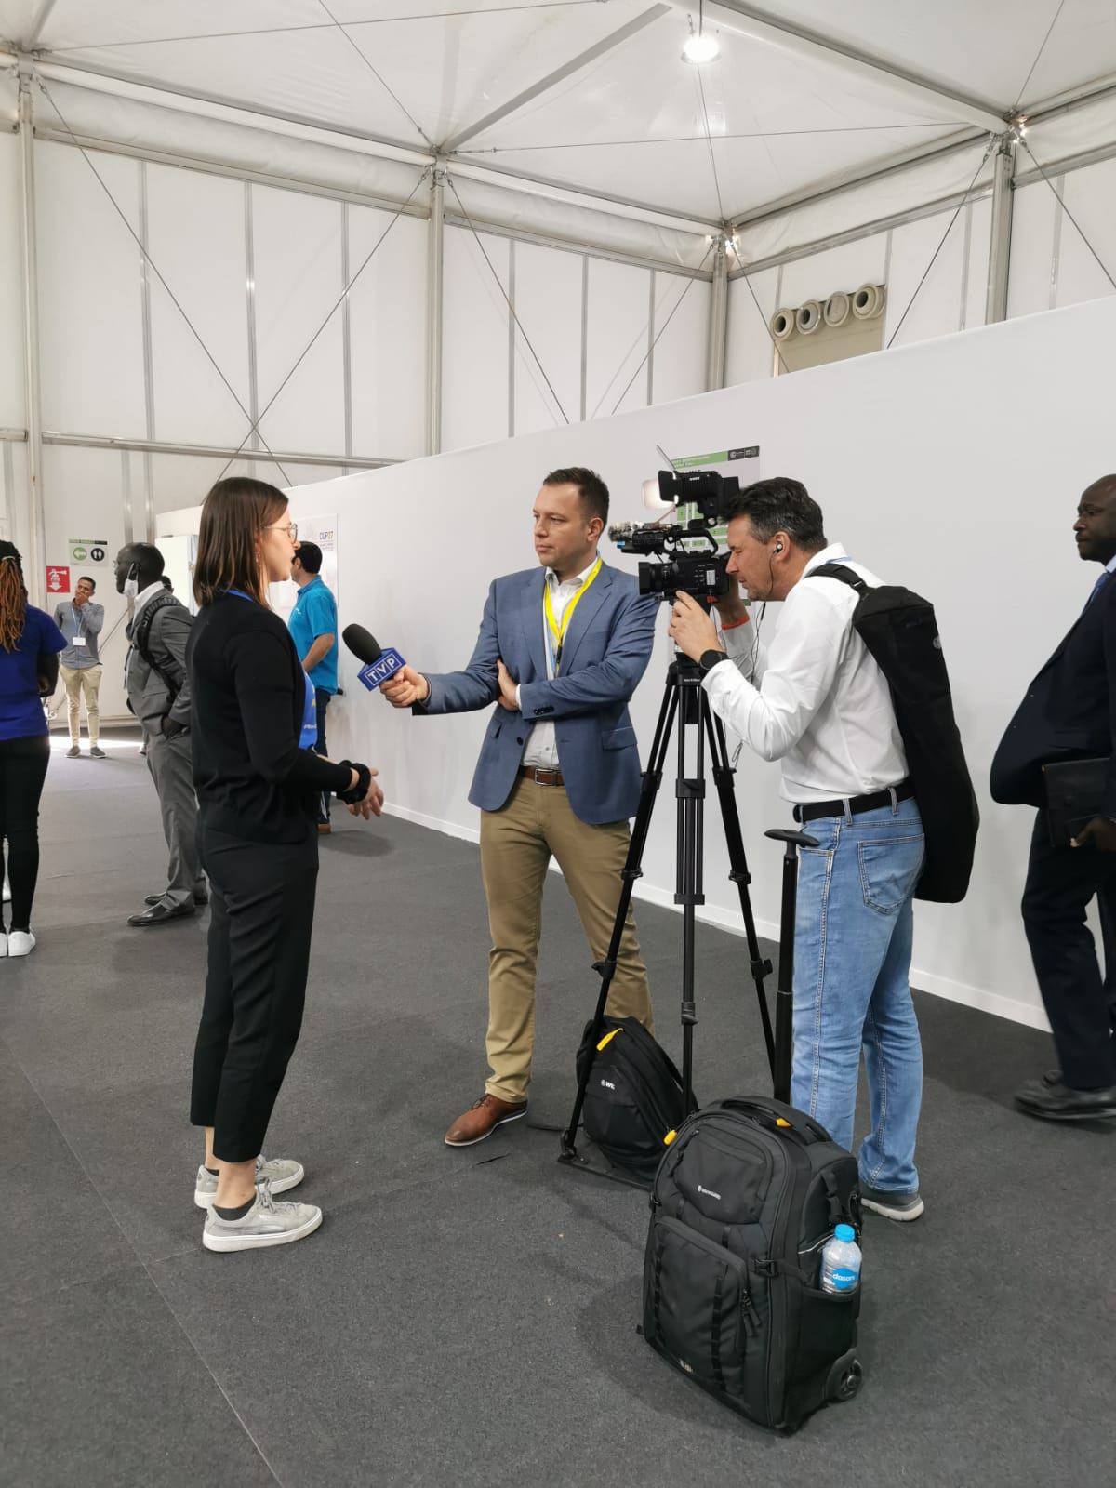
A trustworthy source of information on nuclear
  International media turns to ENS for its trusted, scientific, and technical insights on nuclear events
  ENS Glossary and Nuclear Basics on ENS website serve as essential references for education and general public.

Slide 9
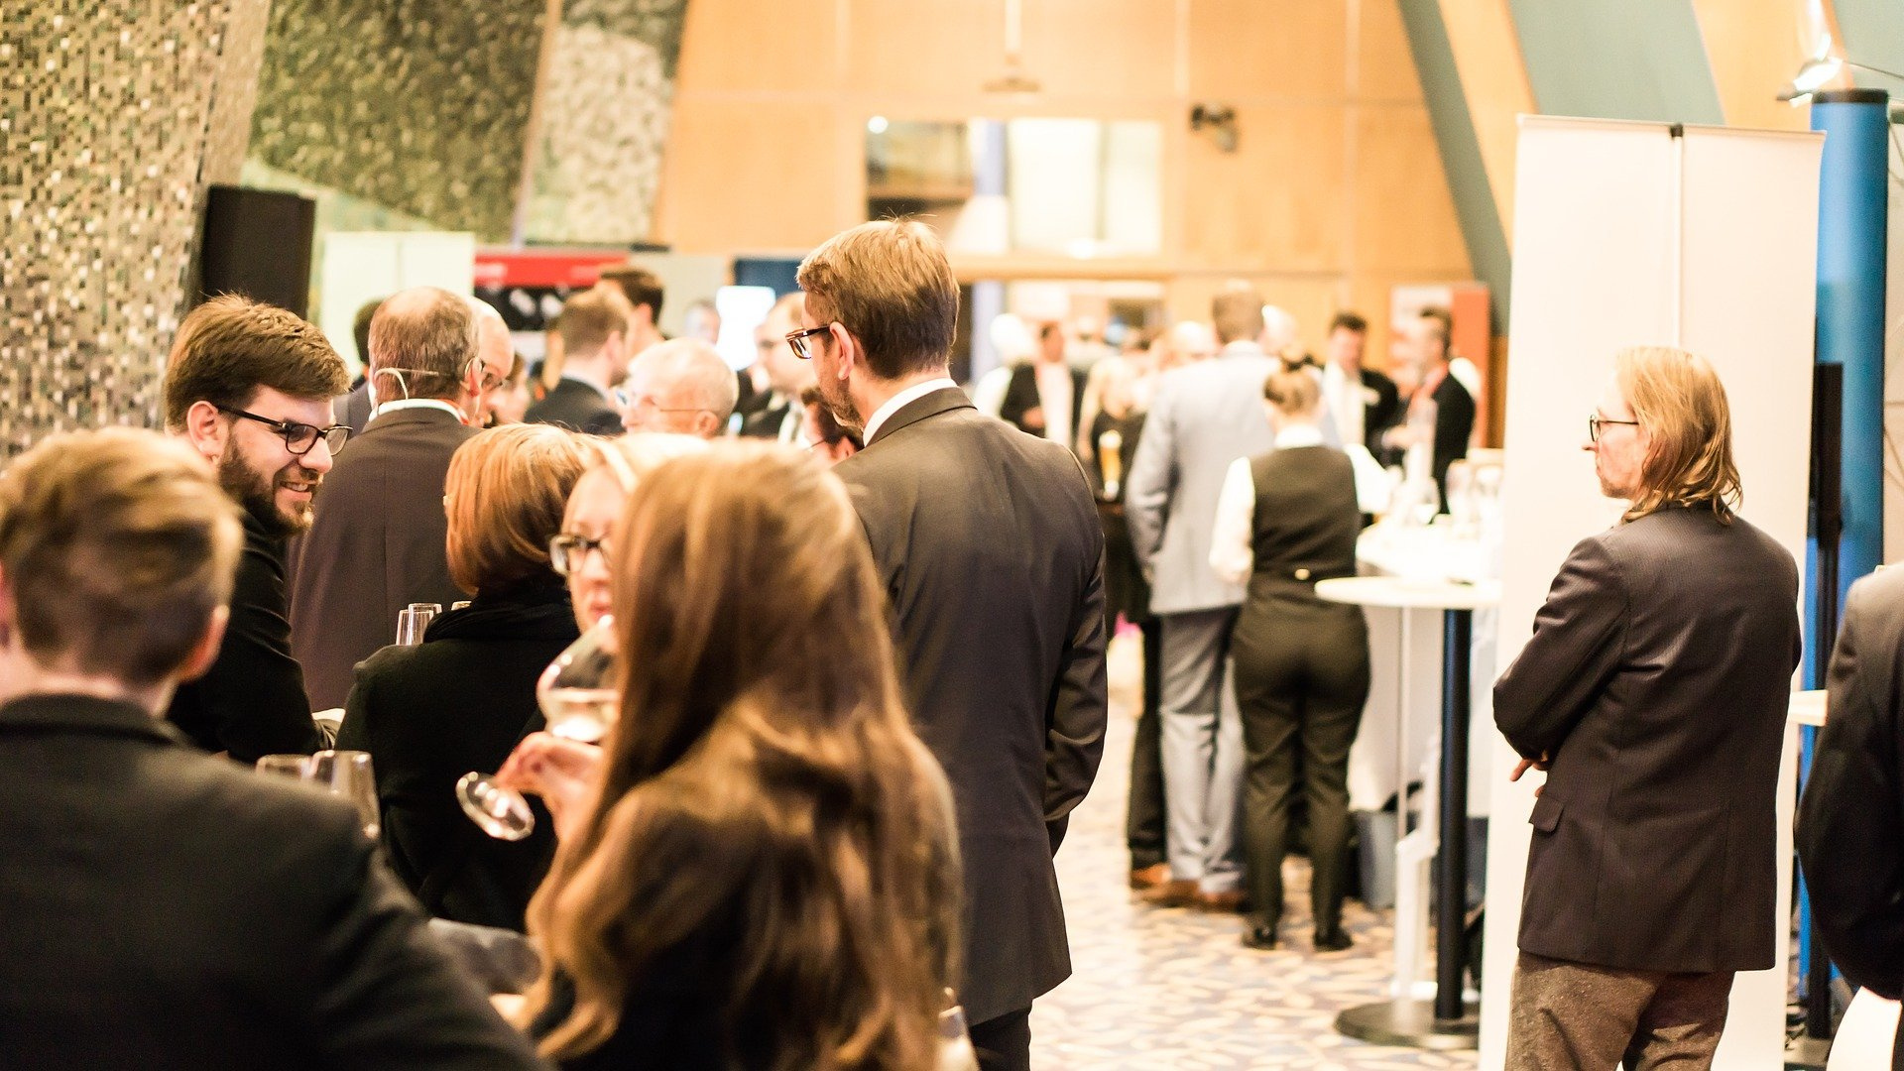
ENS conferences & events
  Every year, ENS gathers its active communities by organising inspiring, high-level conferences and events.
  ENS Conferences focus on research reactors (RRFM), nuclear fuel (TopFuel), E&T (NESTet) ...
  ENS Events offers deep dives into topics like space exploration, nuclear medicine ...

Slide 10

Webinars and workshops, opportunities for
information exchange
  ENS hosts inspiring webinars with its Members and other key stakeholders, to present and discuss the latest achievements and innovations in the nuclear sector
  Professional workshops (e.g. HR & Skills in Nuclear) foster the information exchange and support knowledge management in the ENS community

Slide 11

ENS SM - Followers (2019-2023)
20.000
A growing, engaging
network
15.000
  ENS's social media accounts have been rapidly growing, fostering vibrant networks within the dynamic nuclear sector
  ENS connects with a broad and diverse audience, forming a highly engaged professional community
10.000
5.000
0
2019
2020
2021
2022
2023

Slide 12

Reach out to the community.
ENS Newsletter
  The ENS quarterly newsletters connect over 1,000 subscribers from around the globe
  We collect news, interviews, conferences, and invitations from all our Members, sharing them with our community and keeping it well-informed

Slide 13
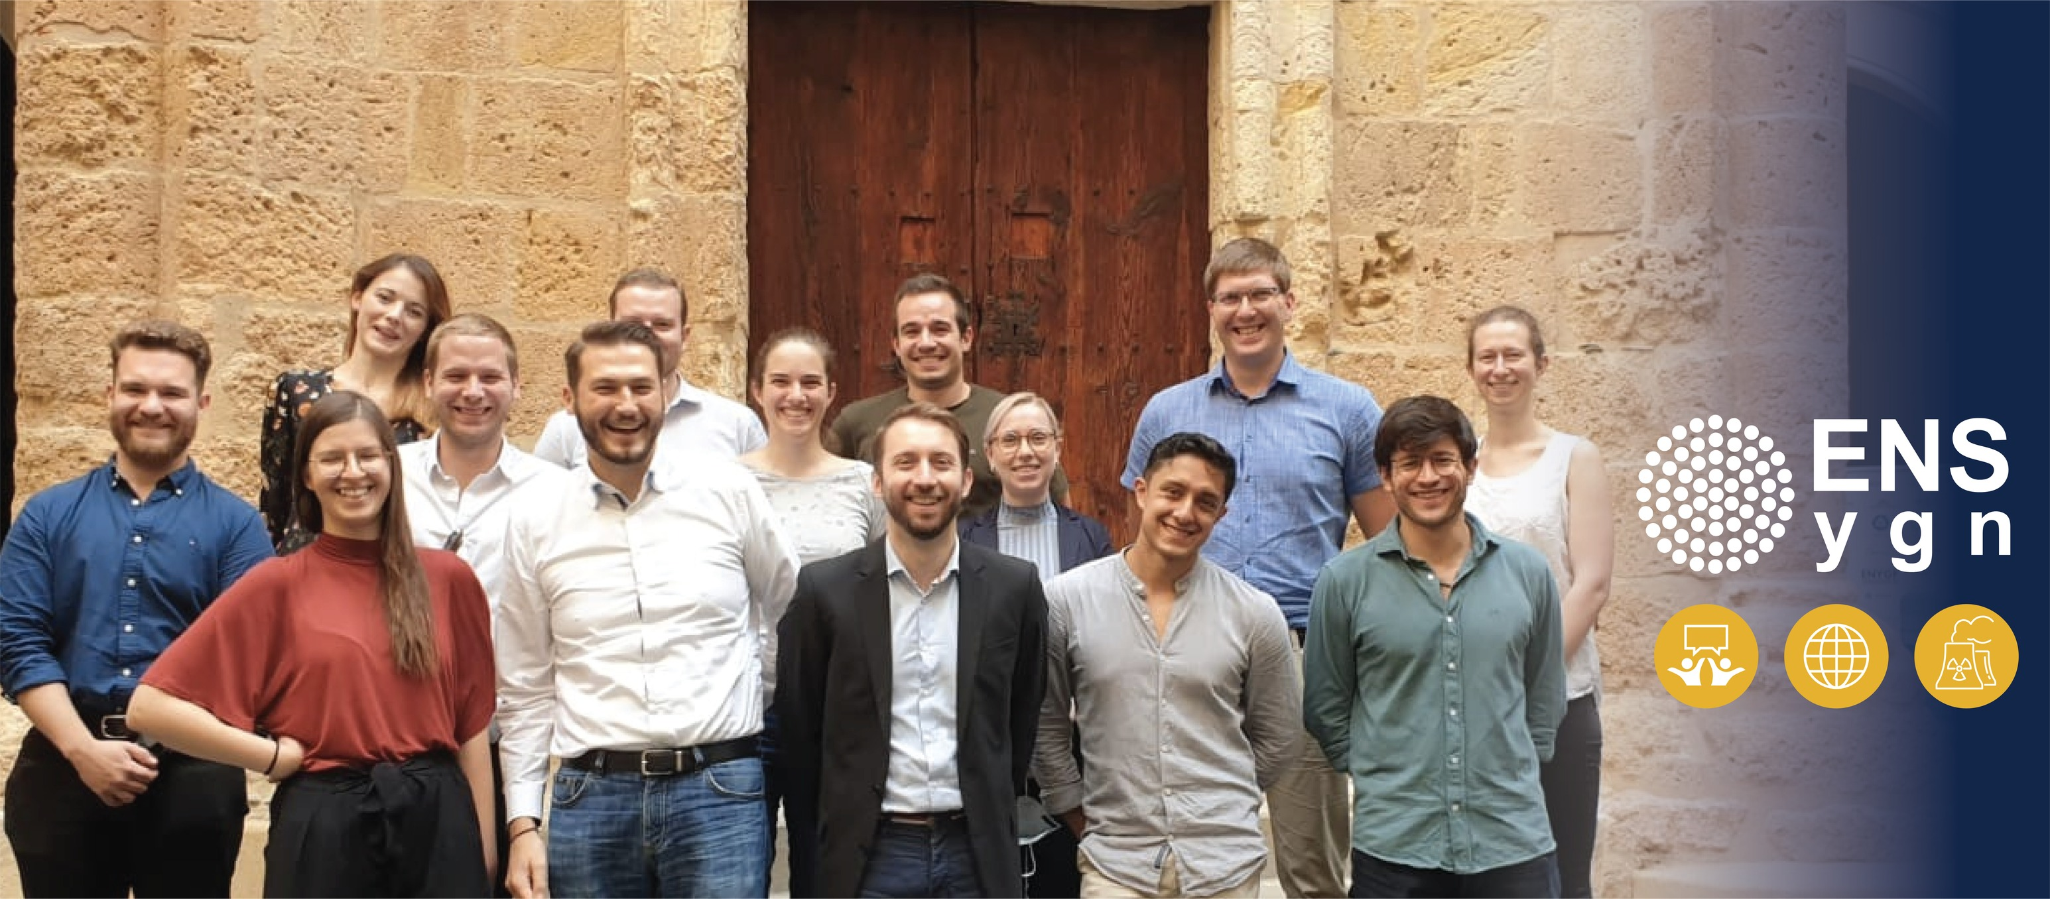
ENS Young Generation Network
Representing over 4000 students and young professionals
Aims
  Vulgarisation of nuclear science and technology
  Attracting and engaging with youth
  Local and continental networking
Organising activities and projects, e.g.
  ENYGF (conference)
  I4N (innovation contest)

Slide 14
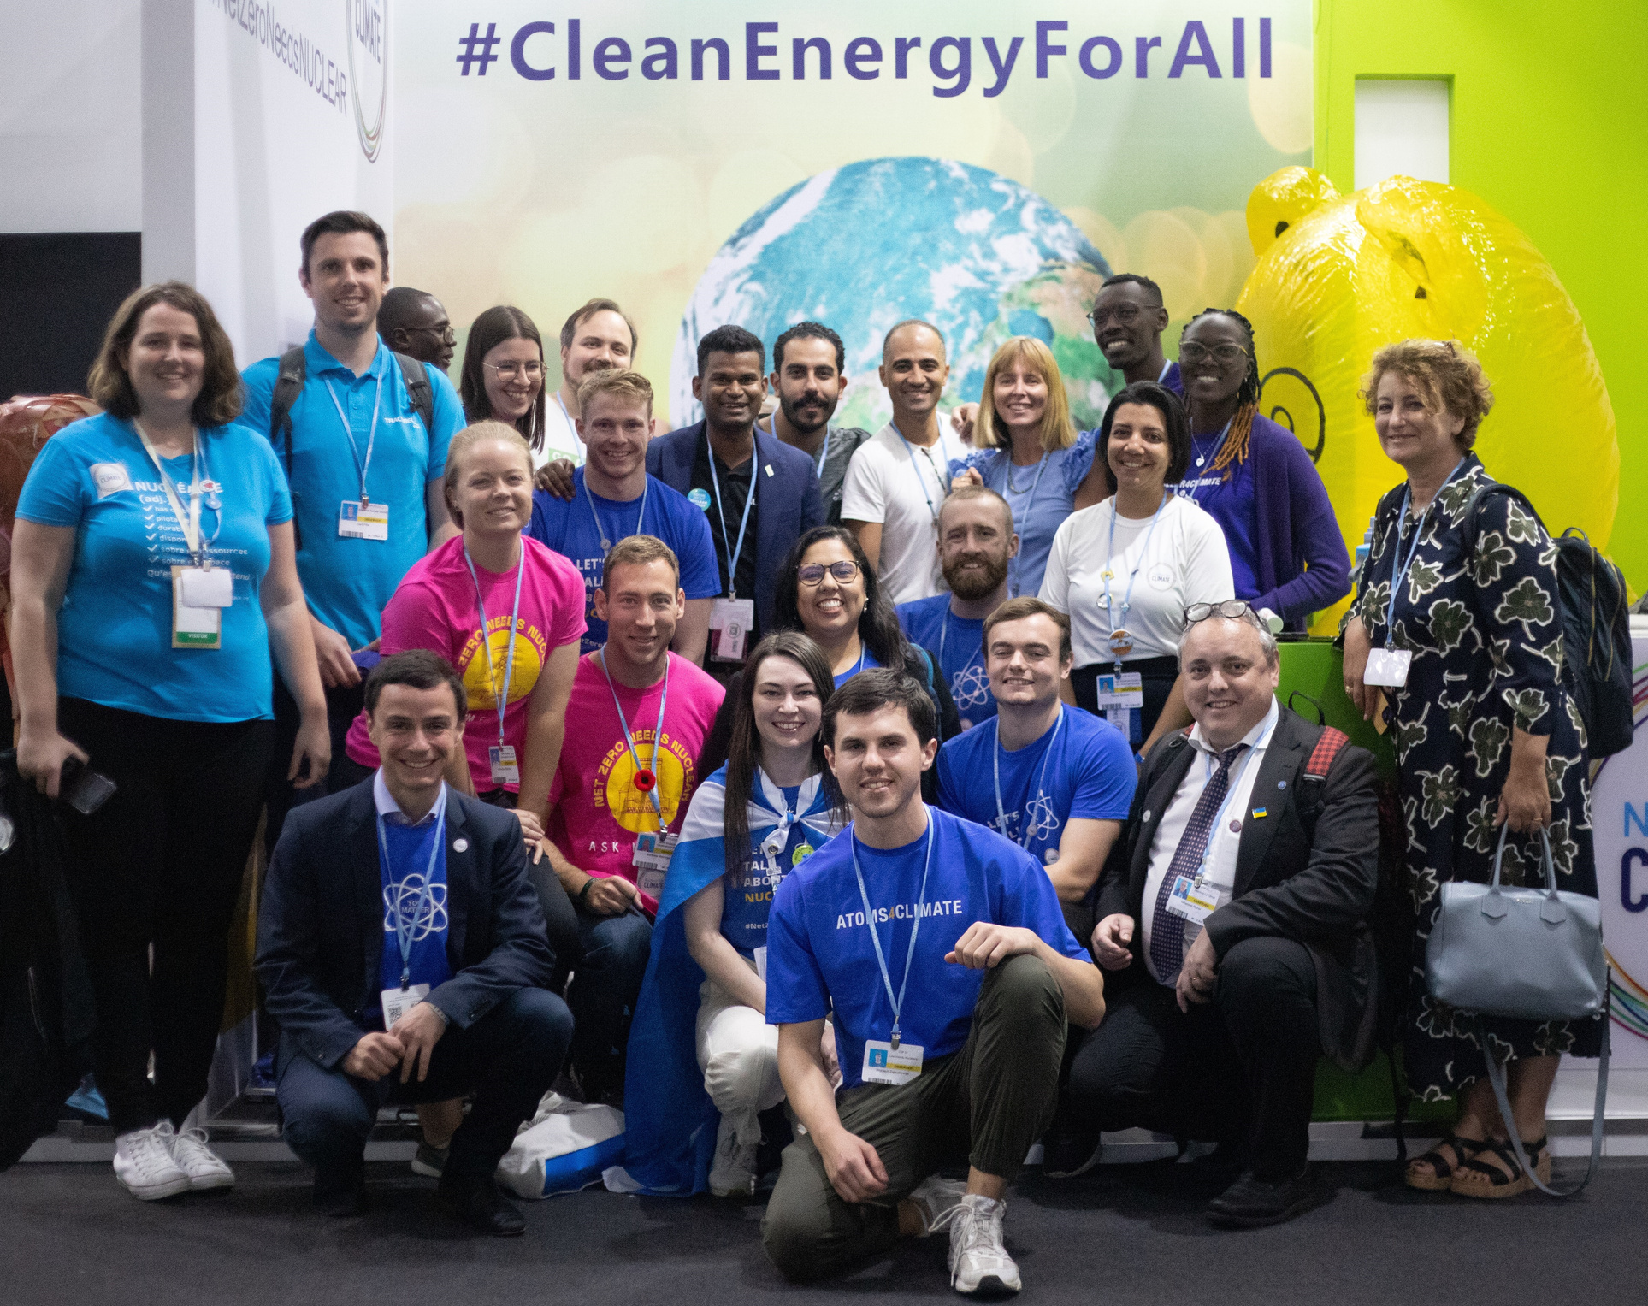
Nuclear for Climate
  A grassroots, youth-led initiative gathering +150 international nuclear associations
  One goal: supporting the inclusion of nuclear energy among the carbon-free solutions to climate change

Slide 15
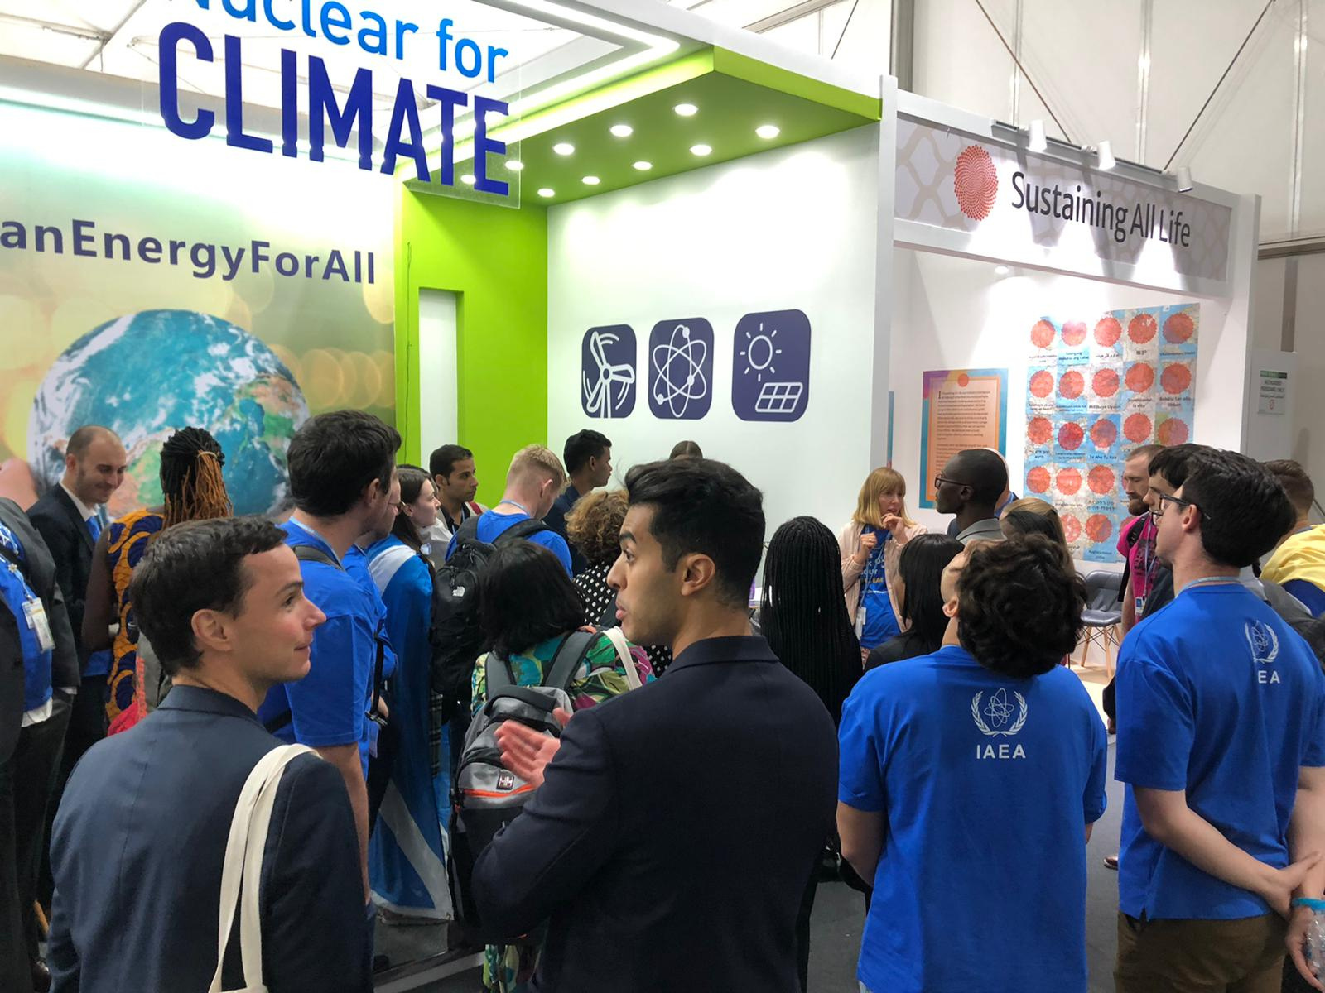
Nuclear for Climate at COPs
  Since 2015, Nuclear for Climate delegations have taken part in UN Climate Change Conferences (COPs)
  Every year, international volunteers organise events and communication campaigns
  At COPs, Nuclear for Climate has a dedicated booth full of activities attracting thousands of visitors

Slide 16

Future plans
  Participation in IAEA General Conference in Vienna (25-29 Sept. 2023)
  ENS Event on Uranium Supply and Conversion (with Euratom Supply Agency), Brussels, 25 Oct. 2023
  Participation in World Nuclear Exhibition, Paris (28-30 Nov. 2023)
  Nuclear for Climate delegation at COP 28, Dubai, 30 Nov. - 12 Dec. 2023
  European Research Reactor Conference (RRFM 2024), Warsaw, Spring 2024

Slide 17
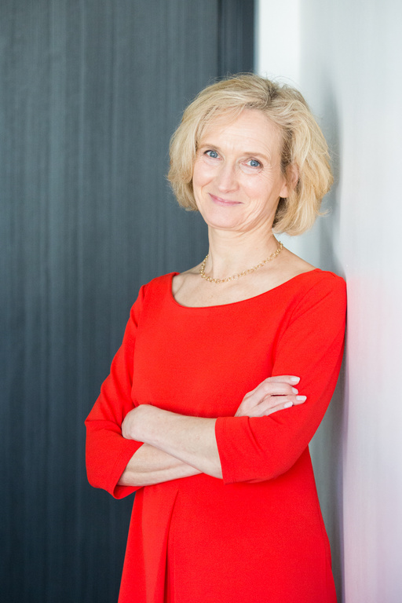
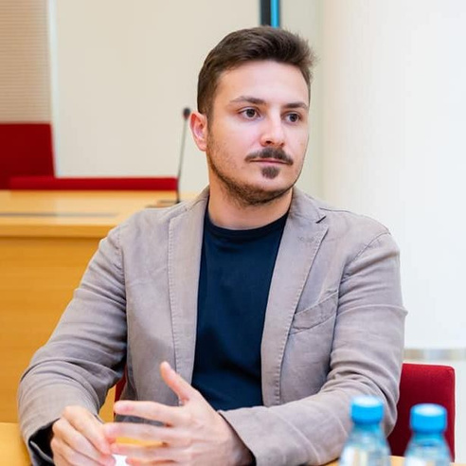
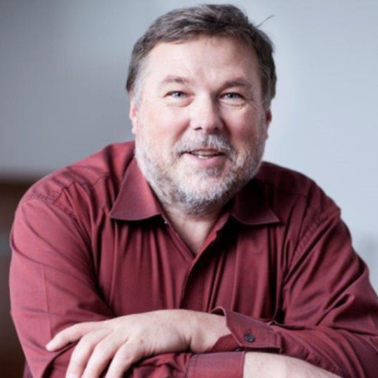
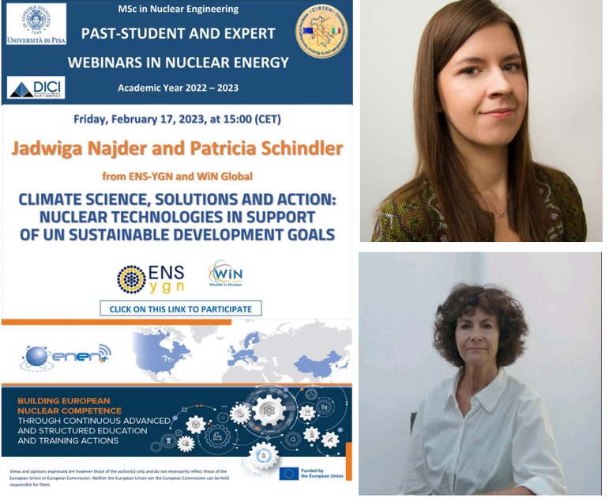
Contact us
Kirsten Epskamp
Mattia Baldoni
Secretary General
kirsten.epskamp@euronuclear.org
Communications Officer
mattia.baldoni@euronuclear.org
Prof. Leon Cizelj
Jadwiga Najder
ENS President
leon.cizelj@ijs.si
Science and Outreach Manager
jadwiga.najder@euronuclear.org

Slide 18





THANK YOU
CONTACT
Avenue des Arts 56, Brussels, Belgium
+32 2 505 30 50
www.euronuclear.org
We look forward to working with you
christian.legrain@euronuclear.org

