Slide 1
Korean Nuclear Energy Activities
Sep. 27, 2023
Bum-Jin CHUNG
Korean Nuclear Society
(Kyung Hee University)

Slide 2

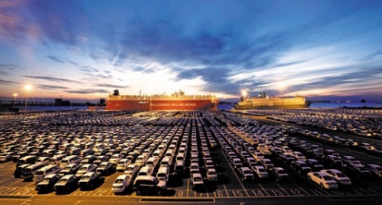
Energy Imports of Korea
Korea lacks natural resources including renewable resources
  imports 95% of energy
  corresponds to 25% national import
  corresponds to the profits from semiconductor and auto exports: Two major export areas of Korea
Annual Energy Imports: ~100 billion$
Breakdown : Oil (73.1%), LNG (18.8%), Coal (9.9), Uranium(0.9%)

Slide 3
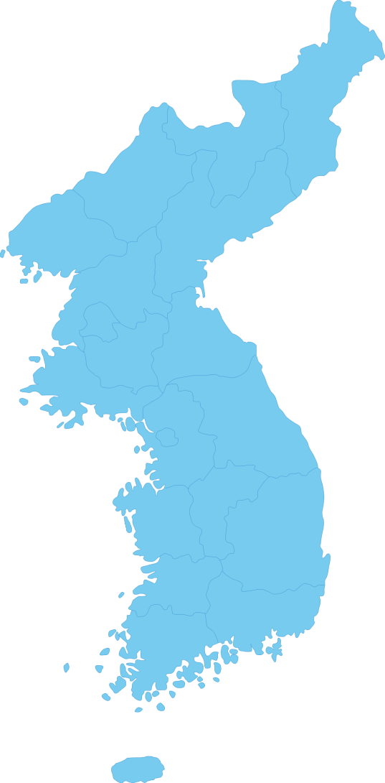

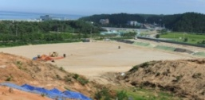


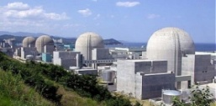

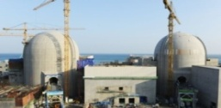
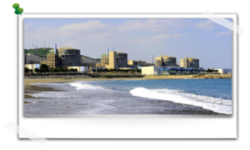

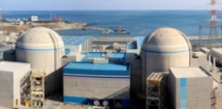

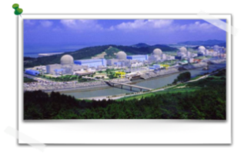

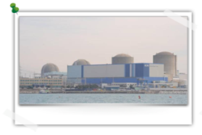



Nuclear Power Plants in Korea
25 NPPs in operation (2023)
3 units under construction
Kori #1 and Wolsong # 1 shutdown permanently
4 planned NPPs canceled
2 NPP constructions suspended
(Resume construction soon)
Chunji, Daejin
4 units
Shin-Hanul
4 units
Hanul
6 units
Electricity cost (~110 \/kWh) and share
Nuclear ~60 \/kWh (30%)
Coal ~80 \/kWh (40%) → 150 W/kWh
LNG ~120 \/kWh (20%) → 280 W/kWh
Others ~200 \/kWh (10%) → 270 W/kWh
Shin-Wolsong
2 units
Seoul
Wolsong
4 units
Hanbit
6 units
Shin-Kori
6 units
Kori
4 units
Yongkwang→ Hanbit
Uljin → Hanul
In Operation
Under Construction
Under Planning
Permanent shutdown
Notes:
• Korea has 24 nuclear power plants in operation at four sites as you see in this slide.
• Among them 20 units are Pressurized Water Reactors (PWR), and the others are Pressurized Heavy Water Reactors.
• Nuclear power, providing one-third of total electricity in Korea, has been a key for the Korean economy and energy security.

Slide 4


Supply Chain for Nuclear Project
KEPCO
E&C
KEPCO
NF
A/E + NSSS
DESIGN
DOOSAN
Continuous construction over 30 years
NUCLEAR
FUEL SUPPLY
EQUIPMENT
SUPPLY
KEPCO
KHNP
High-quality system
KEPCO
KPS
NUCLEAR UTILITY
PROJECT MANAGEMENT
& COMMISSIONING
Self-reliance of A/E, Equipment, Fuel
Construction Co.
Gradual localization of BOP
PLANT
MAINTENANCE
CONSTURUCTION
KAERI
World best constructors
R & D
Rich experience in overseas projects
such as Burj Khalifa
6

Slide 5
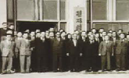

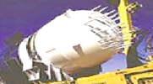
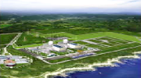
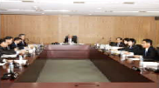

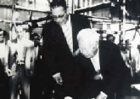
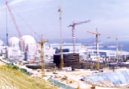
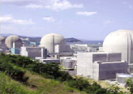
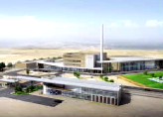
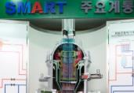
Korean Nuclear Energy at a Glance
1958
1962
1980
2000
2011
2015
Enactment of
Atomic Energy Act
Construction of
The first Research
Reactor, TRIGA
Mark II
Establishment of Localization
Plan (’84)
Advanced Reactor Development
of APR1400 and SMART
Establishment of Nuclear Safety
and Security Commission (NSSC)
Signed SMART PPE with Saudi
1959
1970
1990
2009
2012
Establishment of Office of Atomic Energy & Atomic Energy Research Institute
Introduction of
Nuclear Power
Construction of
Kori Unit 1
(’71~78)
Technology Self-Reliance
Development
of OPR1000
Won contracts
for a JRTR in Jordan, and 4 APR1400 in the UAE (Successful construction)
Acquired Standard Design Approval for SMART
Notes:
한국은 1950년대 말, 관련 법령을 제정하고 조직을 설립하는 등 꾸준히 원자력발전 관련 기술개발에 투자하였으며 1962년 트리가마크 II 연구용원자로를 건설한 바 있습니다.
Let me start by saying the brief history about nuclear energy in Korea. In the late 1950’s, Korea made a steady effort in developing nuclear R&D like promulgating series of atomic energy laws together with the nuclear organizations. Moreover, a small research reactor TRIGA Mark-II was constructed in 1962.
1978년 첫번째 상업용 원전을 건설하였으며, 뒤이어 1980년대에 핵연료 국산화에 성공하게 됩니다. 또한 정부의 지속적인 투자와 연구진들의 끊임없는 노력으로 APR 1400과 SMART 개발에 성공하여 ’09년 UAE에 APR 1400 모델 수출 및 2015년 9월에는 사우디에서 스마트 원전 건설 전 상세설계(PPE, Pre-Project Engineering)협약을 체결하게 되었습니다.
Kori Unit 1, nation’s first NPP supplied by the US Westinghouse turnkey project, went into commercial operation in 1978 followed by the successful localization of nuclear fuels for pressurized heavy water in the 1980’s. After the constant pursuit of investment from the government coupled with the efforts by nuclear industries, academia and research institutes, the painstaking efforts finally began to bear fruit as Korea developed APR 1400 and SMAR, small-Medium sized reactor, followed by the export of New Korean PWR model, APR 1400, to the United Arab Emirates in 2009, the first turnkey project nuclear export from Korea.
In addition, Korea signed the SMART PPE agreement with Saudi Arabia in September 2015

Slide 6

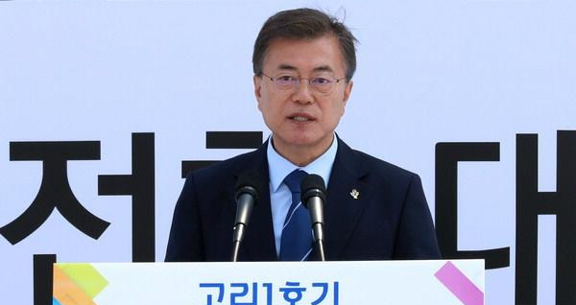
Energy Transition Policy
Nuclear Phase-out policy declared at the permanent shutdown ceremony of Kori #1:
  Reduction of nuclear and coal portions
  Expansion of renewables
  (de facto expansion of LNG)
  Cancellation of 4 planned NPPs
  Suspension of 4 NPPs in construction
  (Shin-Kori 5&6, Shin-Hanul 3&4)
Huge protests from the nuclear society, the press, opposition parties, etc.
  Several brave professors have stood against the policy.
Current situation
  70% of the public continuously show pro-nuclear views.
  Realities of the renewables have been recognized. (Undespatchability, Intermittency, Electricity instability, High cost, Land devastation, etc.)
  Positive recognition enhanced for nuclear power as the clean energy source tackling climate change.
  New President Yoon declared ‘Scrapping nuclear phase-out policy’.
Phasing out Nuclear Declaration(2017. 6. 19)

Slide 7
Net Zero Emission (CO₂ free)
2019 Energy consumption by form
  Electricity (44.8 million TOE) from nuclear, coal, oil, LNG, renewables, etc
  Fossil fuels (186.6 million TOE) from coal, oil, LNG, etc.
  → Net Zero required for Fossil fuels (4 times larger than electricity) as well.
  → Transition to Electricity and/or Hydrogen (Carriers) required.
  (Carbon free electricity and Carbon free hydrogen?)
2019 Energy consumption by sector
  Industry (142.9 million TOE), Transportation (43 million TOE), Home (22.6 million TOE), Commercial (17.5 million TOE), Public (5.4 million TOE)
  Almost impossible to achieve NZE without sacrificing industry and commercial sectors (70%).
‘Carbon Free 2050’ Plan of Korea
  Unrealistic (Renewable deployment, Hydrogen import, Super-grid connection,
  Based on Nuclear Phase-out premise
  Cost not calculated (Tremendous)
  → Possible only the renewables are substituted by nuclear.

Slide 8
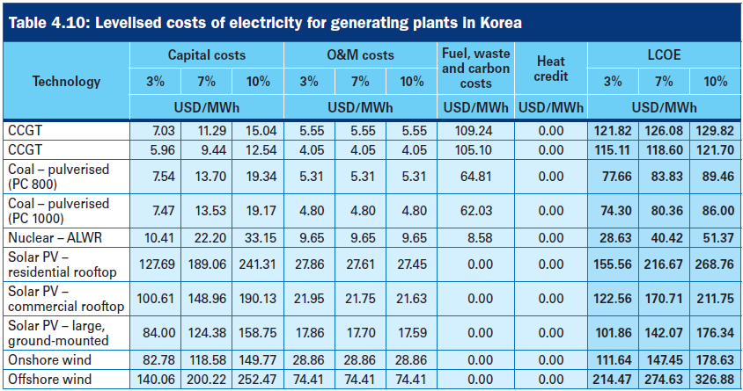
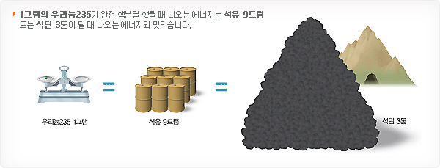
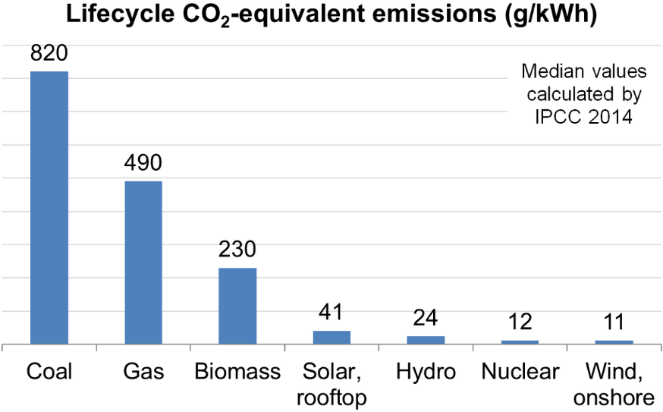
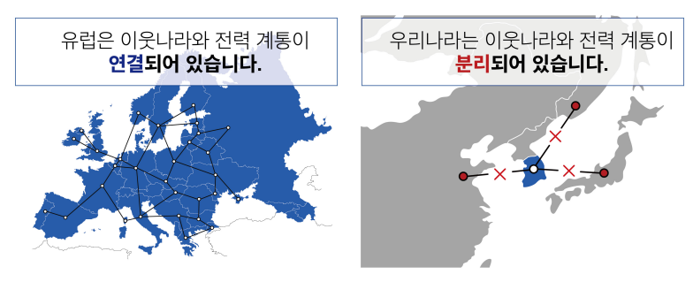
Role of the Nuclear in Korea
Energy Reserve (Energy Security)
Oil : 3.5 months
LNG : 1.5 months
Coal : 0.5 days
Nuclear : 18 months (+10 month)
Comparison
1g U²³⁵
9 drum Oil
3 tons of coal
Independent Grid
11

Slide 9
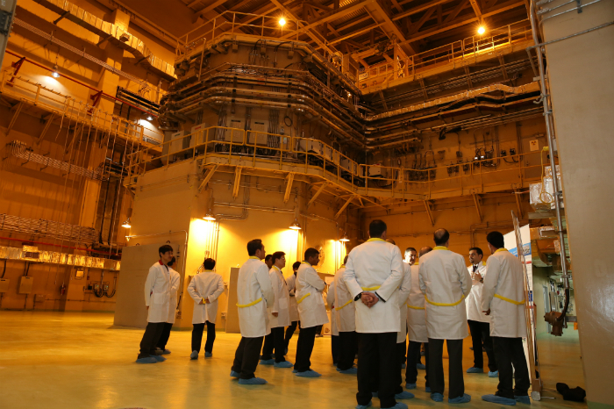
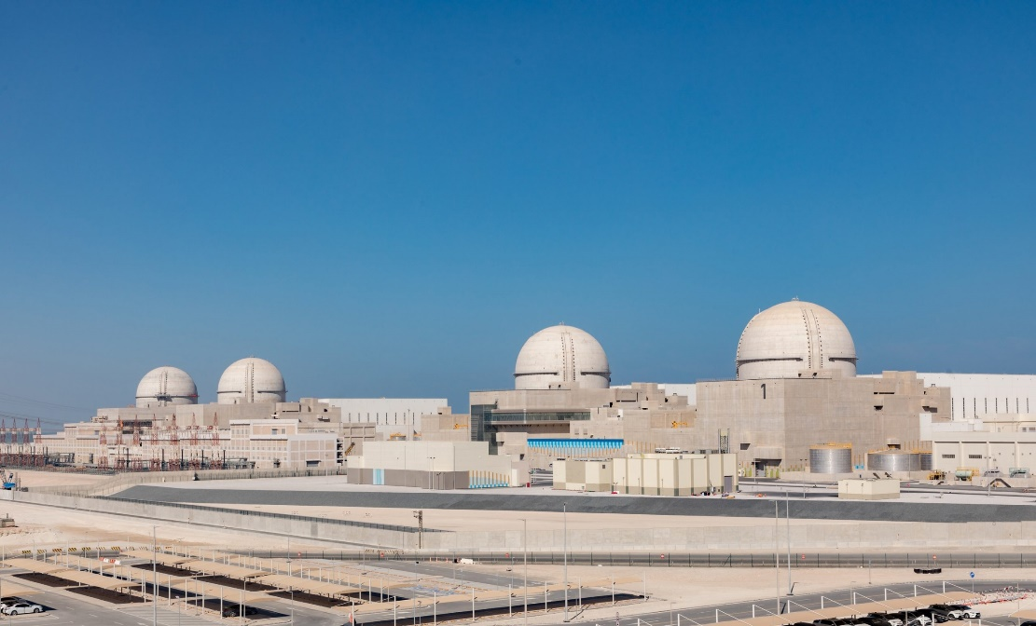
Nuclear Exports
JRTR in 2009
Jordanian Research and Training Reactor
Barakah NPPs in 2009
(Exported with WH)

Slide 10
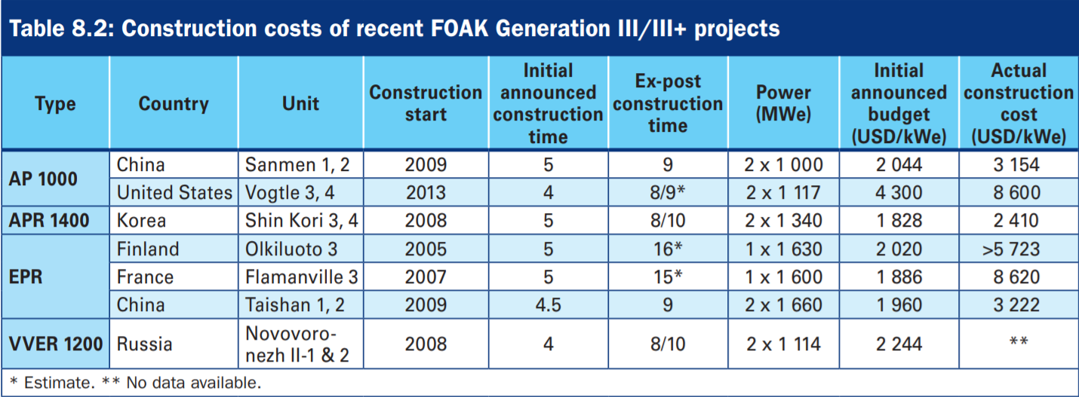
APR1400 Competitiveness
UAE Export 2009 (4 Barakah units)
Economic competitiveness
EU Requirement (Sep. 26, 2017)
NRC Design Certificate (Aug. 26, 2019)
UAE construction record : ‘In-Time’ ‘Within Budget’

Slide 11



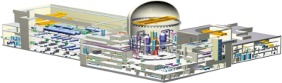
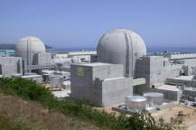

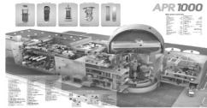





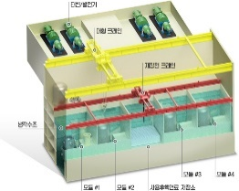
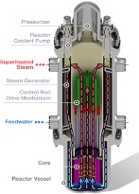


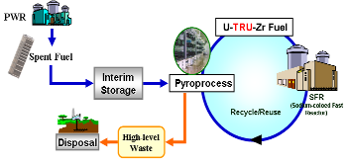










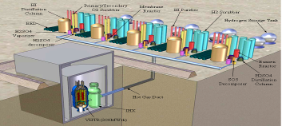
Current and Future NPP Development
APR1400
(EU R. Oct. 2017)
(NRC DC Sep.2018)
Now
APR+
(Construction Pending)
APR1000
Innovative Nuclear System
Near-Term
SMART &
(PPE Saudi Arabia)
i-SMR
SFR fuel cycle
(Sodium-cooled Fast Reactor + Pyroprocess)
Long-Term
Hydrogen Plant
NHDD
(Nuclear Hydrogen development and demonstration)
VHTR

Slide 12
Korean Nuclear Society
Established in 1969.
Members : ~ 6,000
Objectives
  Contribute to the advancement of nuclear engineering and technology
  Promote the peaceful use of nuclear energy and radiation
  Promote cooperation between members
Activities
  Host KNS conferences (2 times a year)
  Foster & coordinate the activities of professional divisions
  Conduct research, consultation & evaluation of projects
  Cooperate with other organizations having similar aims
  sponsoring international conferences and workshops
  Publish academic journal (Nuclear Engineering & Technology)
  Encourage members by honors and awards
  Foster nuclear engineering education both domestic & international students (scholarship to young students)

Slide 13
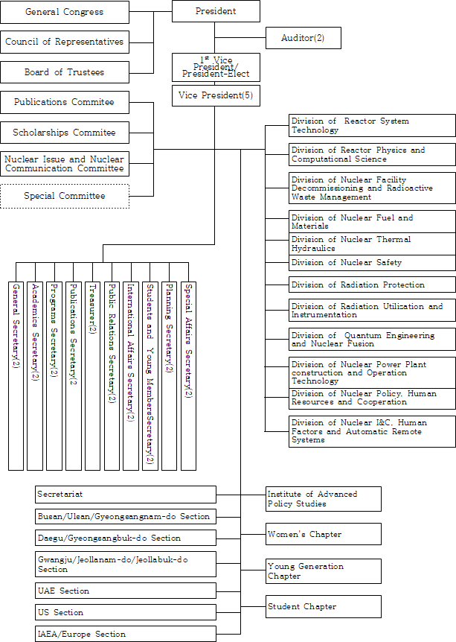
Organization
(Board of Directors)
1 President
1 Chief vice-president (elected)
5 vice-presidents (nominated)
20 Secretaries
2 Auditors
(Members)
~260 Board of Trustees
~6,000 Members
12 Research divisions
Several committees
1 High level policy institute

Slide 14
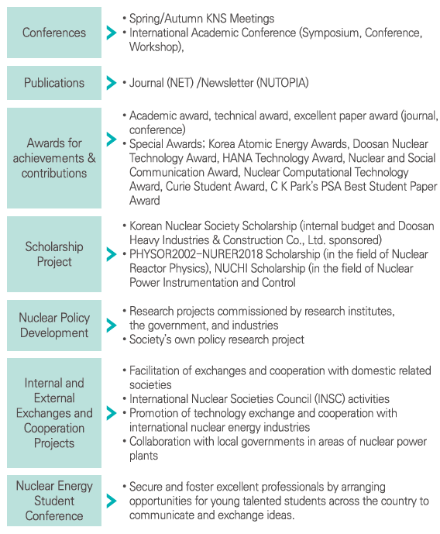
Major Activities
(Internal)
Spring/Autumn Conferences
NET journal
Awards
Scholarships
Nuclear policy institutes
(External)
Public education
Press releases
Policy statements

Slide 15
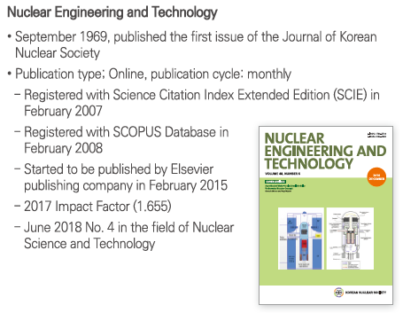
NET and its JIF and Rank

Slide 16
Nuclear Journal Rank
1 | INTERNATIONAL JOURNAL OF ENERGY RESEARCH | 4.6
2 | JOURNAL OF NUCLEAR MATERIALS | 3.1
3 | RADIATION PHYSICS AND CHEMISTRY | 2.9
4 | Nuclear Science and Techniques | 2.8
5 | Nuclear Engineering and Technology | 2.7
6 | Progress in Nuclear Energy | 2.7
7 | INTERNATIONAL JOURNAL OF RADIATION BIOLOGY | 2.6
8 | Nuclear Materials and Energy | 2.6
9 | HEALTH PHYSICS | 2.2
10 | RADIATION MEASUREMENTS | 2
11 | ANNALS OF NUCLEAR ENERGY | 1.9
12 | IEEE TRANSACTIONS ON NUCLEAR SCIENCE | 1.8
13 | RADIOCHIMICA ACTA | 1.8
14 | FUSION ENGINEERING AND DESIGN | 1.7
15 | NUCLEAR ENGINEERING AND DESIGN | 1.7
16 | Applied Radiation and Isotopes | 1.6
17 | JOURNAL OF RADIOANALYTICAL AND NUCLEAR CHEMISTRY | 1.6
18 | JOURNAL OF RADIOLOGICAL PROTECTION | 1.5
19 | NUCLEAR TECHNOLOGY | 1.5
20 | NUCLEAR INSTRUMENTS & METHODS IN PHYSICS RESEARCH SECTION A-ACCELERATORS SPECTROMETERS DETECTORS AND ASSOCIATED EQUIPMENT | 1.4
21 | NUCLEAR INSTRUMENTS & METHODS IN PHYSICS RESEARCH SECTION B-BEAM INTERACTIONS WITH MATERIALS AND ATOMS | 1.3
22 | JOURNAL OF NUCLEAR SCIENCE AND TECHNOLOGY | 1.2
23 | NUCLEAR SCIENCE AND ENGINEERING | 1.2
24 | Nuclear Technology & Radiation Protection | 1.2
25 | JOURNAL OF FUSION ENERGY | 1.1
26 | RADIOPROTECTION | 1.1
27 | Science and Technology of Nuclear Installations | 1.1
28 | Radiation Effects and Defects in Solids | 1
29 | RADIATION PROTECTION DOSIMETRY | 1
30 | FUSION SCIENCE AND TECHNOLOGY | 0.9
31 | NUCLEAR ENGINEERING INTERNATIONAL | 0.6
32 | ATOMIC ENERGY | 0.5
33 | KERNTECHNIK | 0.5
34 | ATW-INTERNATIONAL JOURNAL FOR NUCLEAR POWER | 0.1

Slide 17
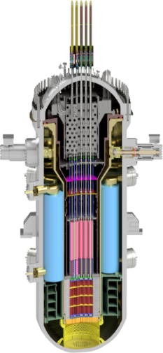
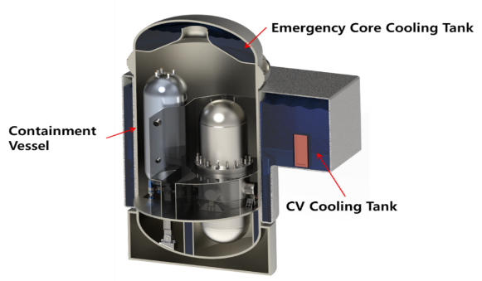
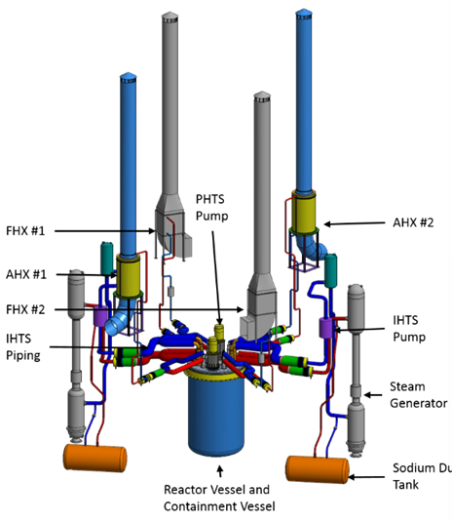
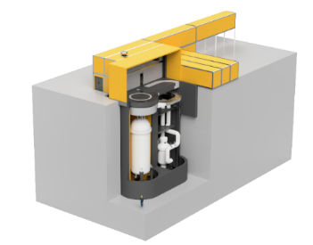
K-SMRs
1997
SMART Project Initiation
2012
SMART Standard Design Approval
2014
SMART Safety Enhancement Project
2015
Korea-Saudi Arabia SMART partnership
SMART
2016
BANDI Conceptual Design
BANDI
2018
MMR CNL Demonstration Project (USNC)
2020
PGSFR Basic Design
2021
i-SMR Project Initiation
2022
BANDI Conceptual Design
2023
SMART100 Standard Design Approval
PGSFR
USNC MMR
i-SMR

Slide 18
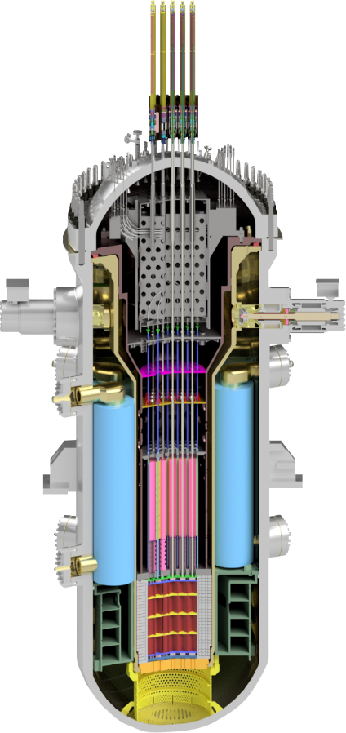






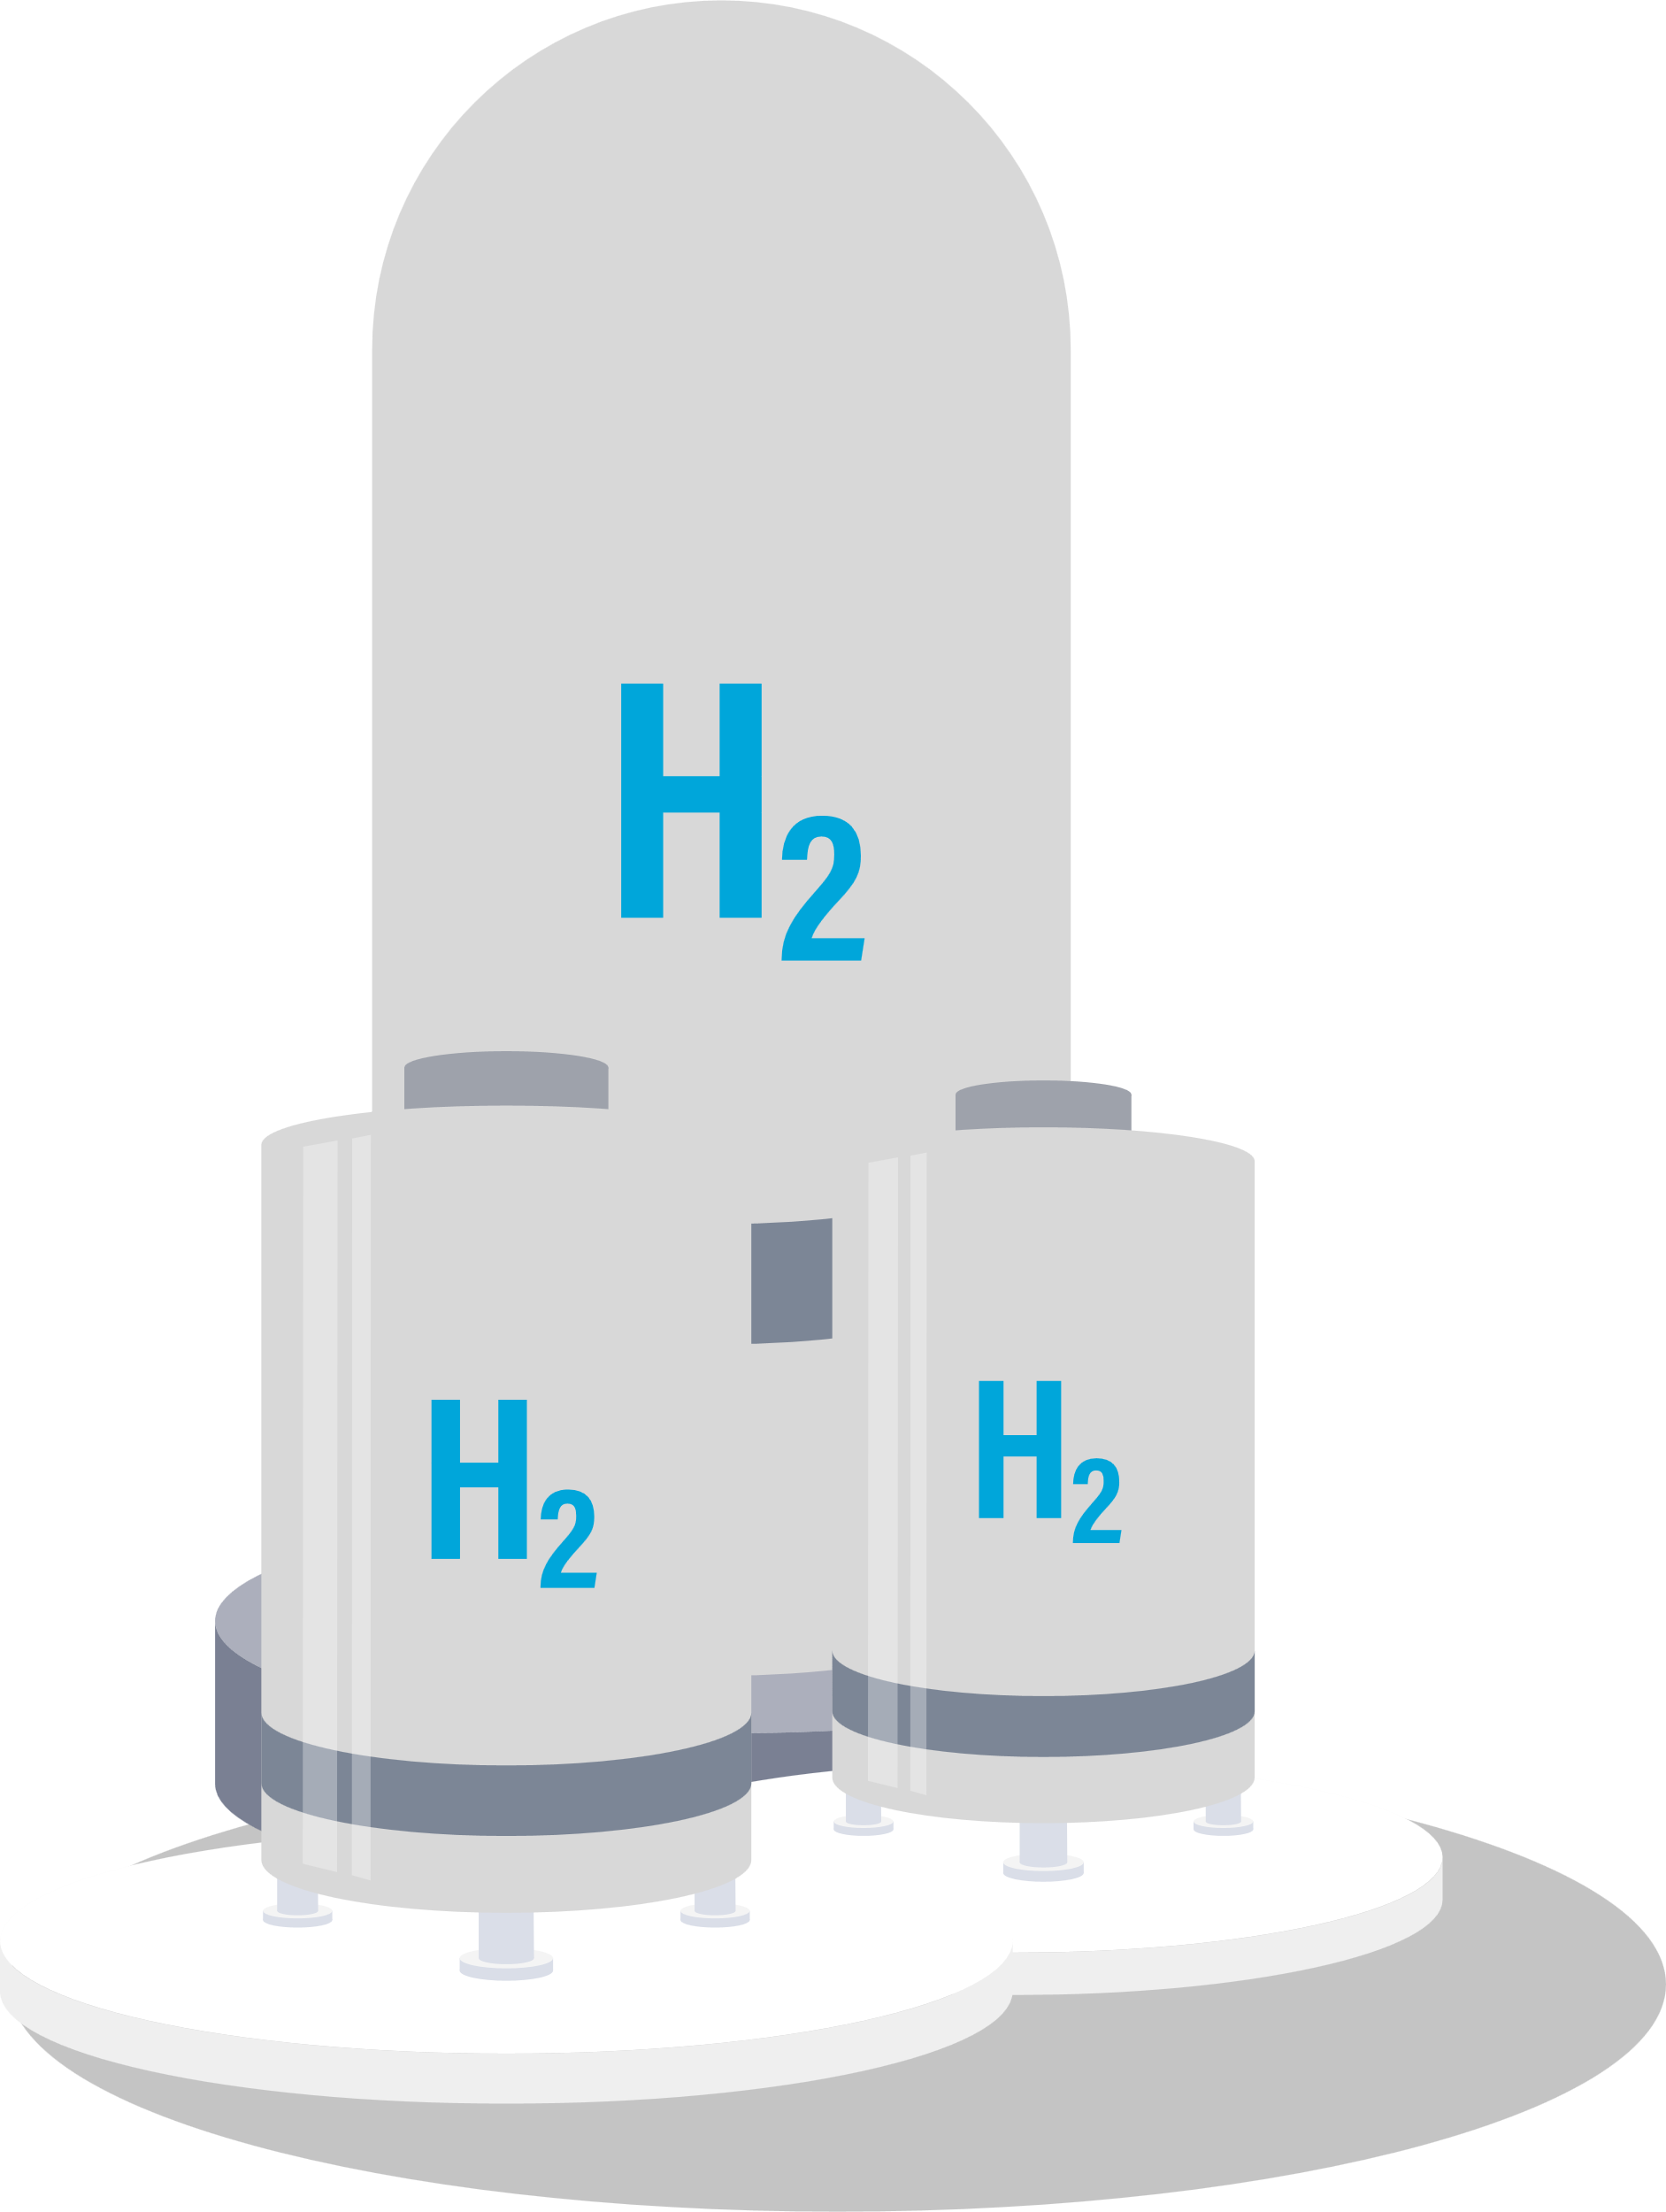
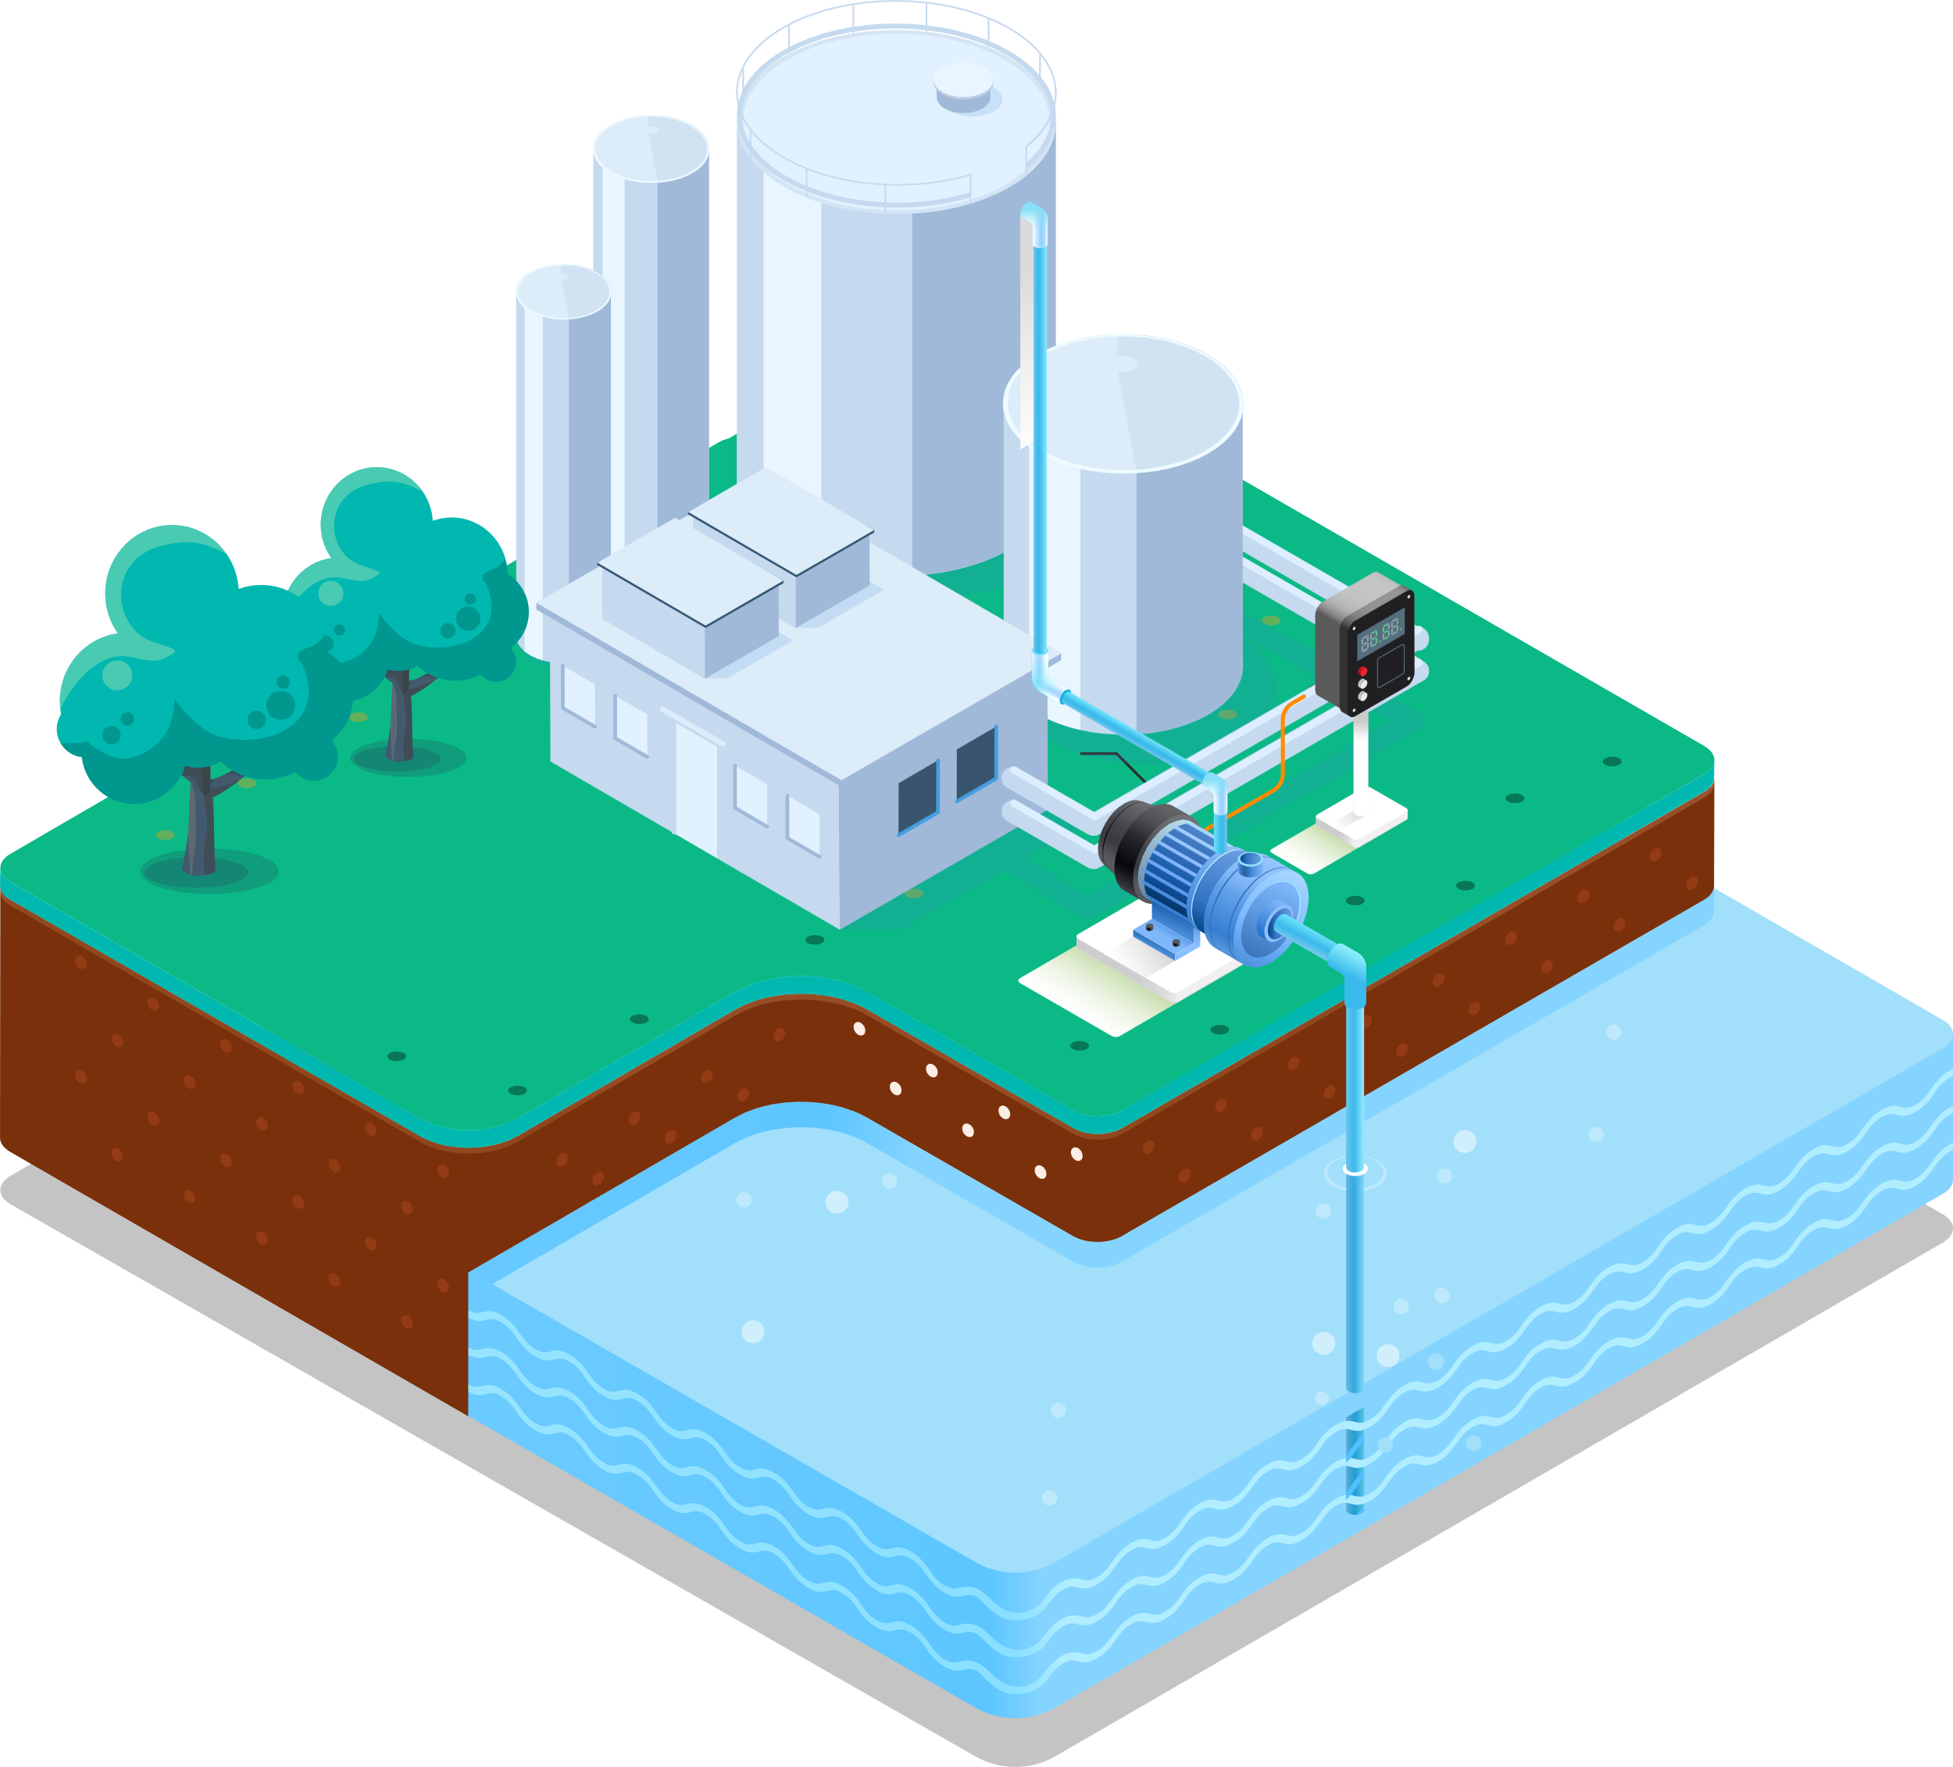
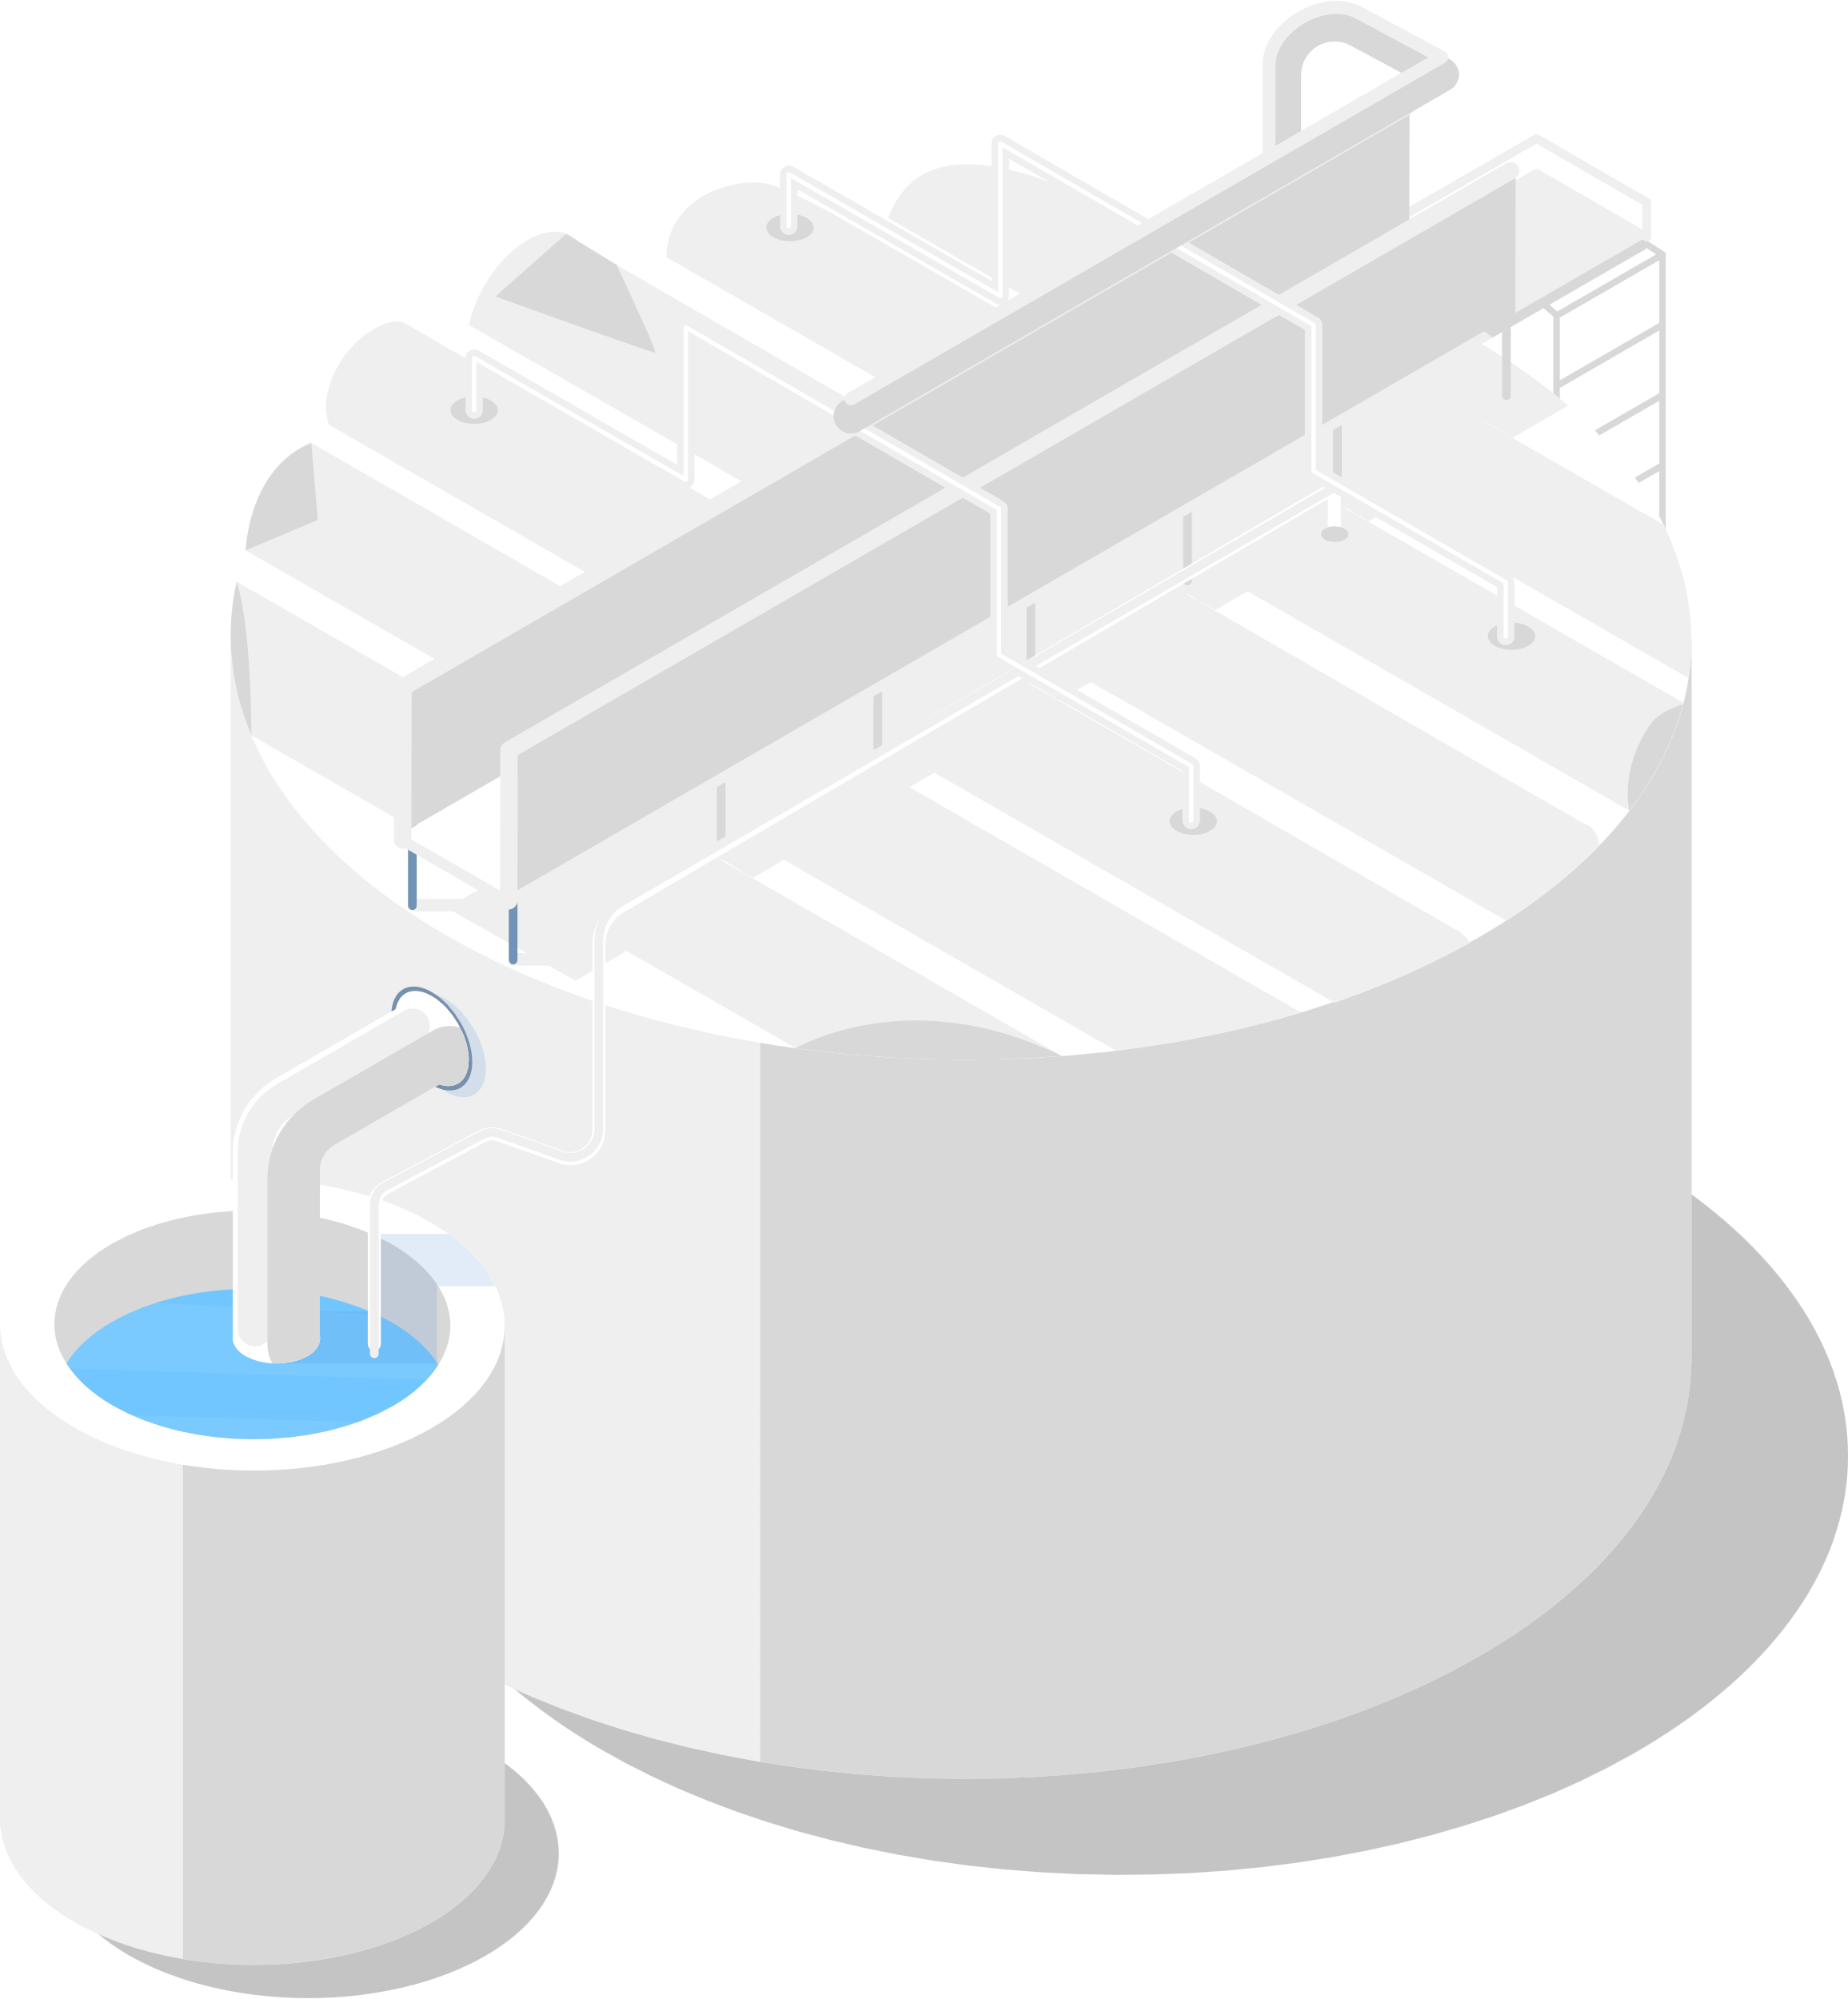
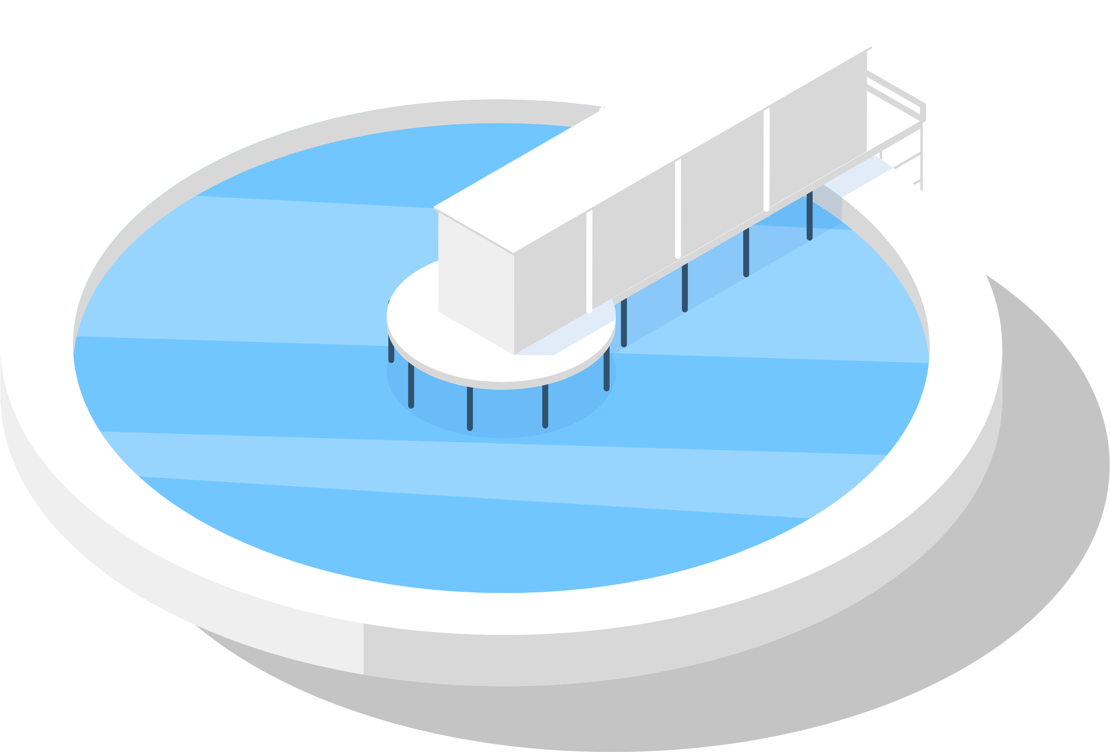

SMART(System-integrated Modular Advanced ReacTor)
Electricity
Steam Transformer
Hot Water
Heat supply
Steam
  For Electricity Generation and
  District Heating or Desalination
Sea Water
Desalination Plant
Fresh Water

Slide 19


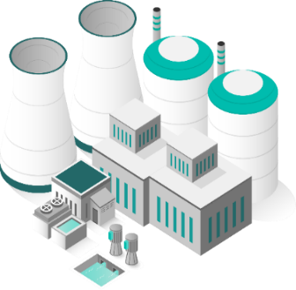
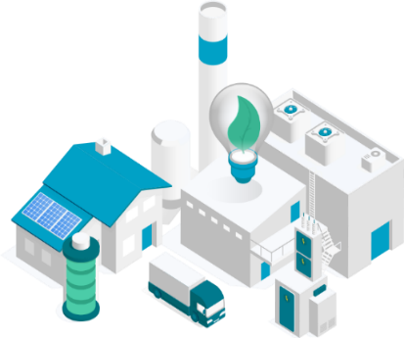
SMART Design Characteristics
  General Information
Thermal Power : 365 MWt
Electric Power : 110 MWe
Desalination : 40,000 ton/day
Design Life : 60 years
  Reactor Coolant System
Design Pressure : 17 MPa
Operating Pressure : 15 MPa
Design Temperature : 360 ℃
Core Inlet/Outlet Temperature : 295.5/322 ℃
  Fuel and Reactor Core
Fuel Type : 17×17 Square FA
Fuel Material : UO₂ (＜5.0 w/o)
  SMART Reactor Assembly
Active Core Height : 2.0 m
Refueling Cycle : 36 months

Slide 20
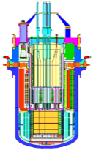

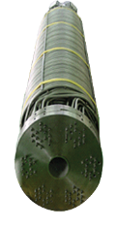
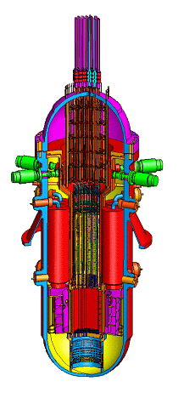











SMART Development
Conceptual
Design
Basic
Design
SMART
Prototype
Pre - Project
Service
97.7~99.3
99.4~02.3
02.7~06.2
06.7~07.6
  1997
  1999
  2002
  2006
  2007
  Safety
  Enhancement
  Standard
  Design Approval
  Technology
  Optimization
12~15
09.1~12.6
07.7~08.12
  2012
  2009
  2008
  SMART
  PPE
  SMART
  SDCA
15.12~18.11
19.1~12.12
  2016
  2019
  2022

Slide 21













Comprehensive Technology Validation and SDA
15
  Fuel TH Tests
  Mechanics and Components
  Thermal - Hydraulics Experiment
Fuel Performance Tests
RPV Dynamics Test, RCP Mockup Test
and Helical ISI Test
TEST Fuel
Vibration TEST
Measurements
TEST Section
PRHRS Heat Ex.
Safety Injection
Pressurizer
CHF Measurement Test
Dynamic Test
RCP TEST Loop
Low Friction Cable
SG Tube Material (A690) Irradiation Test
Spacer Grid
TEST Section
Test Facility
VISTA Integral Test Facility
  SMART - ITL
  SMART - MCR Simulator
World’s Unique and Largest Full
Scope Accident Simulation
1:1 Height, 1/49 Volume
Operator
Supervisory
Operator
Instructor
Systems, Component, and Design Tools have been fully Developed and Licensed
  SMART Standard Design Approval in 2012 (Meet the Most Country’s Licensing Requirements)

Slide 22

SMART FOAK Design

Slide 23


i-SMR Design Characteristics - RCS

Slide 24

i-SMR Safety Systems
03
Passive Auxiliary Feedwater System (PAFS)
Passive Emergency Core Cooling System (PECCS)
Passive Containment Cooling System (PCCS)

Slide 25


i-SMR Development Roadmap
03
12
Standard Design Approval (in Korea) by 2028
Government funding has been started for standard design program this year.
Pre-design review of Korean regulatory body has been already started in July.
SDA acquisition by 2028 and first module installation by 2031

Slide 26










i-SMR Reactor and Major Components
Steam Pressurizer
Canned Motor RCP
TM-ICI
IV-CEDM
Canned Motor Pump(no mechanical seal, No leakage detection system)
CSB
IBA
UGS
Helical SG
Helical coil once-through steam generator
FA support
IV-CEDM support and Cable penetration
Control rod guide and FA support

Slide 27

i-SMR Innovative Technologies

Slide 28


BANDI – Marine-based NPP
03
13
‘Block-type’ reactor coolant system where the reactor vessel the steam generator are ‘nozzle-to-nozzle’ connected to each other without big pipes.
The first phase of the conceptual design of BANDI was started in 2016 and completed in 2022. The second phase will be continued from 2023 to 2028.

Slide 29
Sodium-Cooled Fast Reactor (SALUS-100)
• Completion of SFR (PGSFR) engineering design for TRU burning and core technology development for safety verification
• Development of power generation SMR (SALUS-100) in order to enter the overseas SMR market
※ Canadian vendor review application and technical and business cooperation with ARC

Slide 30



High Temperature Gas Cooled Reactor (MMR++)
• Completed nuclear reactor key-technology development for supplying high-temperature heat necessary for hydrogen production
• Discussion on demonstration reactor linked to industrial process heat and high-temperature water electrolysis hydrogen production unit (MMR++)
※ KAERI provides reactor design (core design and safety analysis)

Slide 31



MSR, Molten Salt Reactor
He Pump
Pump
HX
Plug
Dump Tank
• Selected as “Innovation Challenge Project” in 2021 to secure MSR’s key technology suitable for carbon-free marine systems (’23-’26)
• Development of mobile molten salt reactor (MSR) technology for floating or ship propulsion through industry-academia-research cooperation
※ Joint planning with Samsung Heavy Industries is underway

